Slide 1
Chapter 11 Exception Handling: A Deeper Look

Slide 2
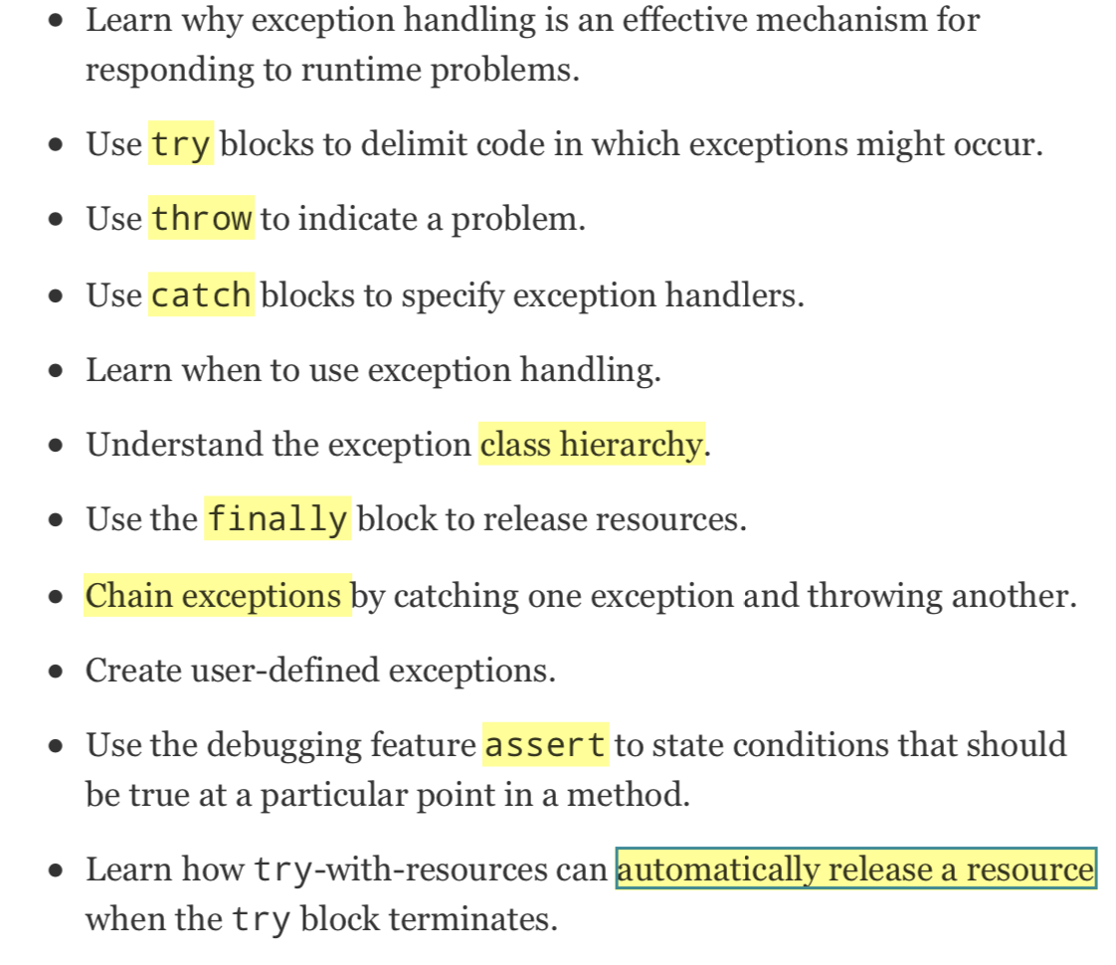
Objectives

Slide 3
11.1 Introduction
Exception handling
Exception—an indication of a problem that occurs during a program’s execution.
The name “exception” implies that the problem occurs infrequently.
With exception handling, a program can continue executing (rather than terminating) after dealing with a problem.
Mission-critical or business-critical computing.
Robust and fault-tolerant programs (i.e., programs that can deal with problems as they arise and continue executing).

Slide 4
11.1 Introduction (Cont.)
ArrayIndexOutOfBoundsException occurs when an attempt is made to access an element past either end of an array.
ClassCastException occurs when an attempt is made to cast an object that does not have an is-a relationship with the type specified in the cast operator.
A NullPointerException occurs when a null reference is used where an object is expected.
Only classes that extend Throwable (package java.lang) directly or indirectly can be used with exception handling.

Slide 5
11.2 Example: Divide by Zero without Exception Handling
Exceptions are thrown (i.e., the exception occurs) when a method detects a problem and is unable to handle it.
Stack trace—information displayed when an exception occurs and is not handled.
Information includes:
The name of the exception in a descriptive message that indicates the problem that occurred
The method-call stack (i.e., the call chain) at the time it occurred. Represents the path of execution that led to the exception method by method.
This information helps you debug the program.

Slide 6
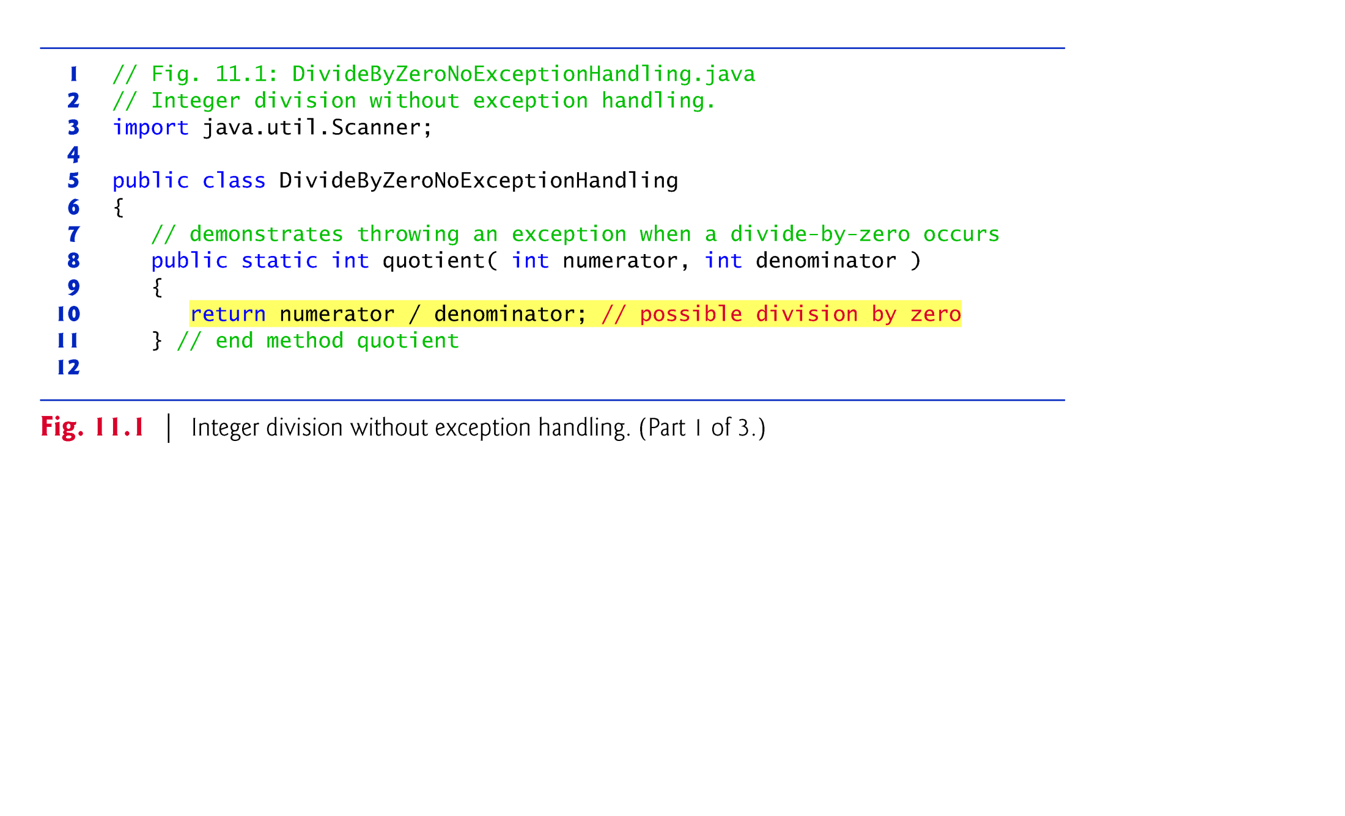

Slide 7
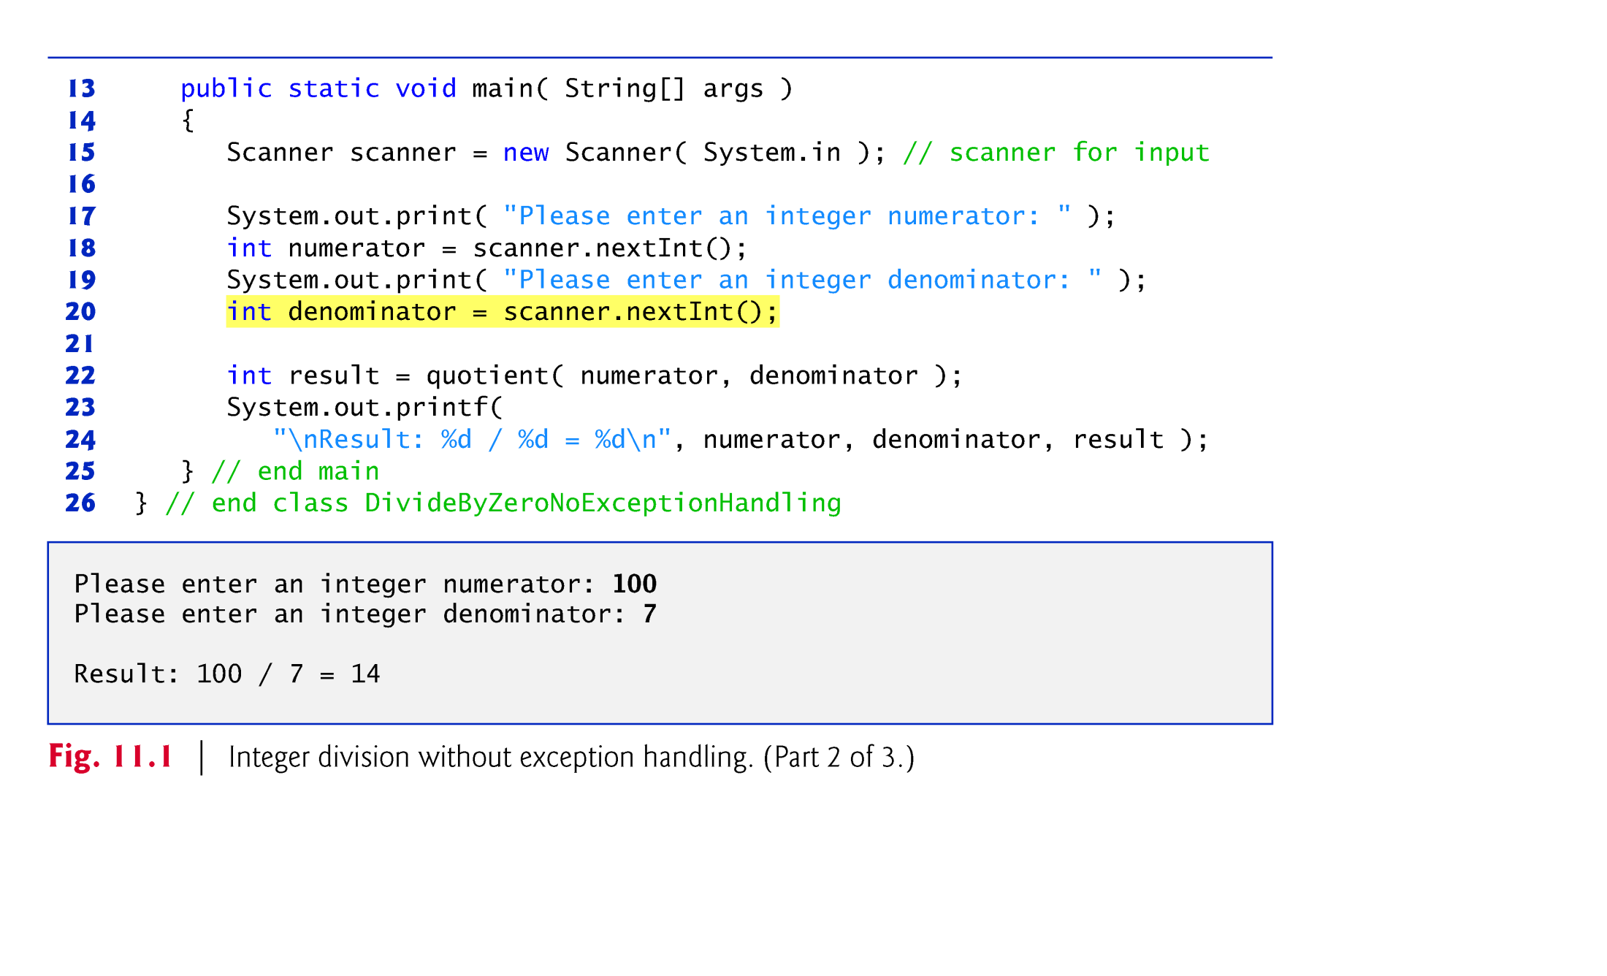

Slide 8
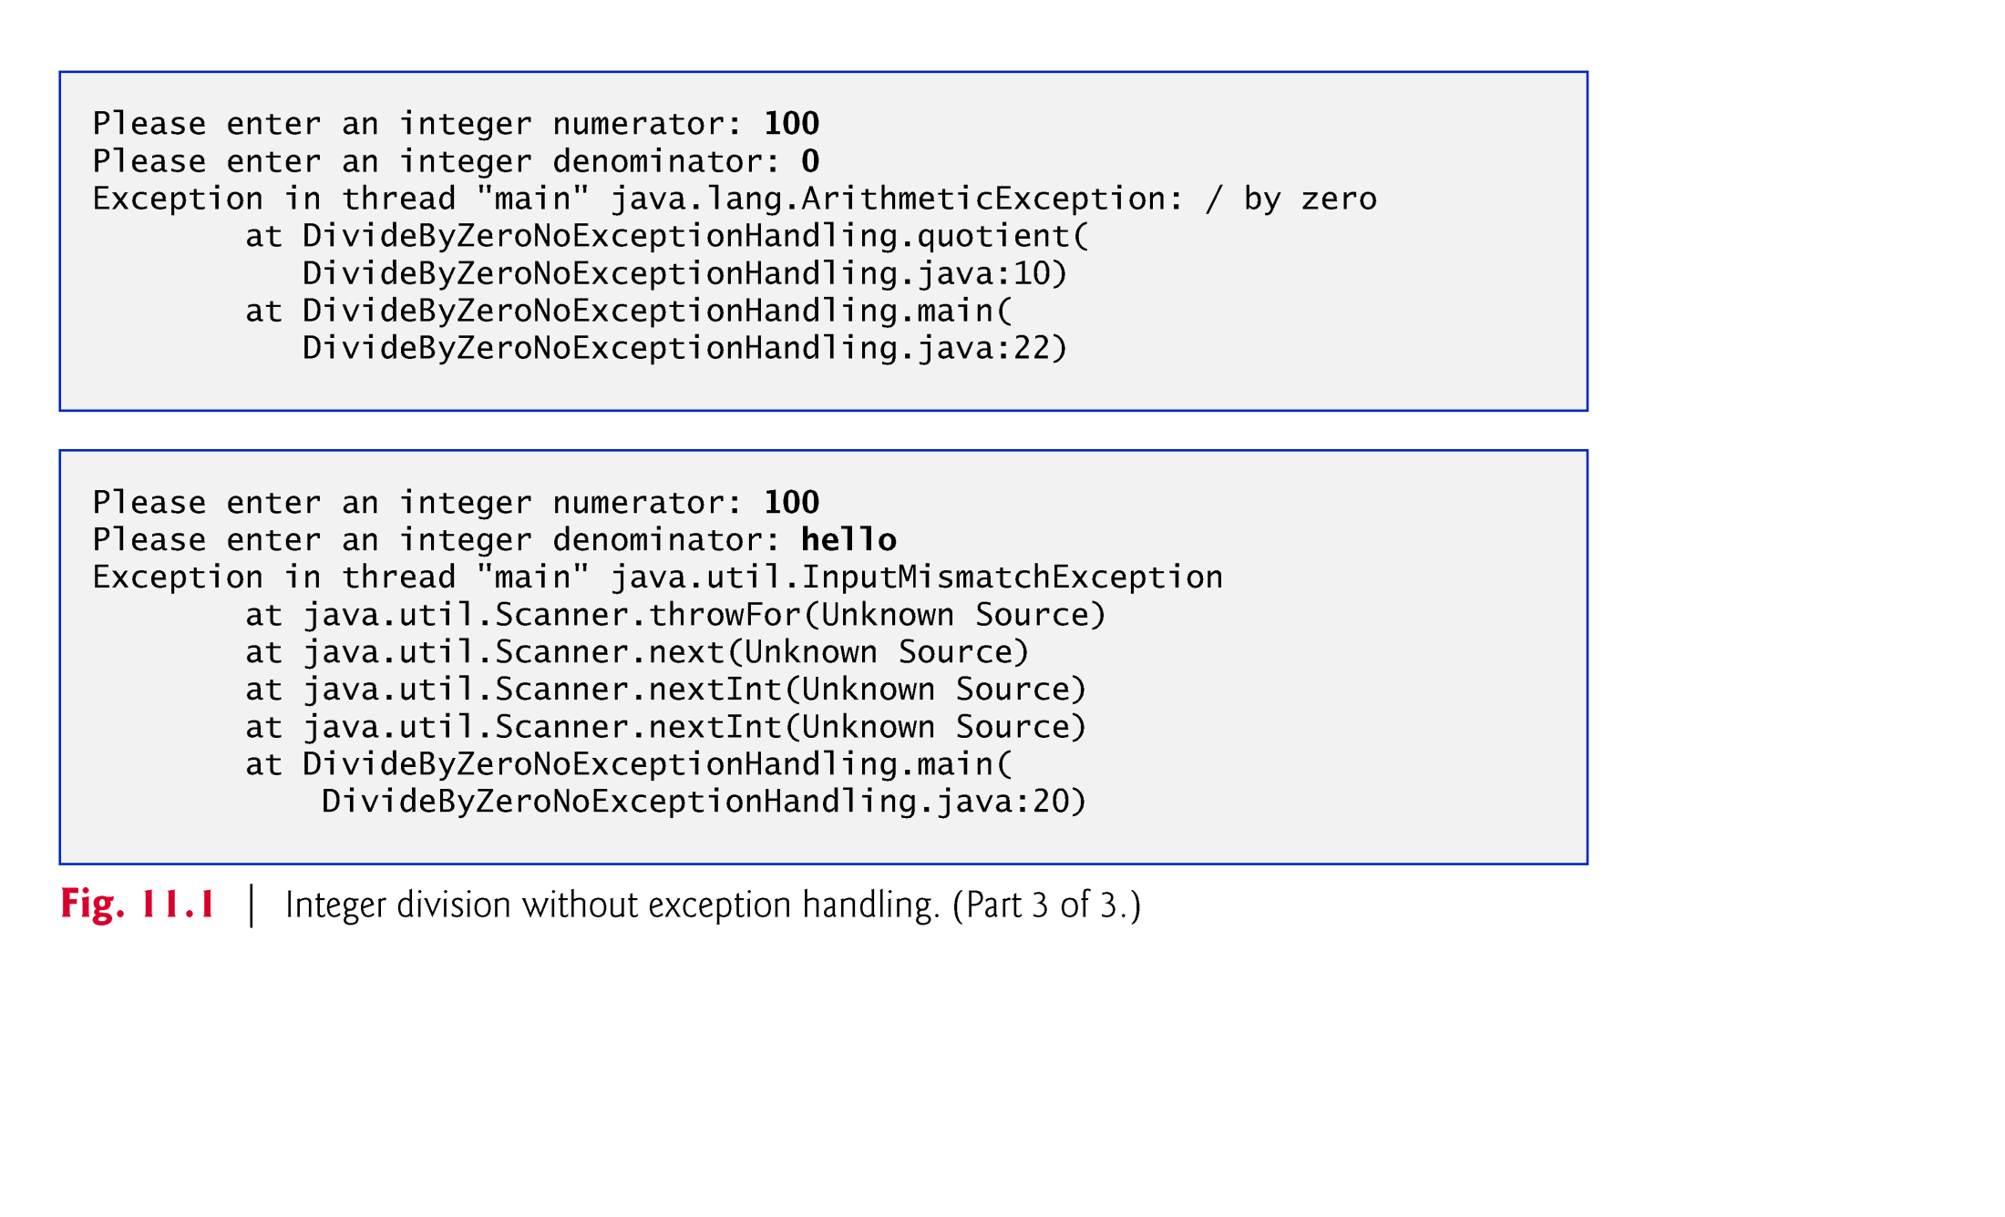

Slide 9
11.2 Example: Divide by Zero without Exception Handling (Cont.)
The top “at” line of the call chain indicates the throw point—the initial point at which the exception occurs.
As you read a stack trace top to bottom, the first “at” line that contains your class name and method name is typically the point in the program that led to the exception.
An InputMismatchException occurs when Scanner method nextInt receives a String that does not represent a valid integer.

Slide 10
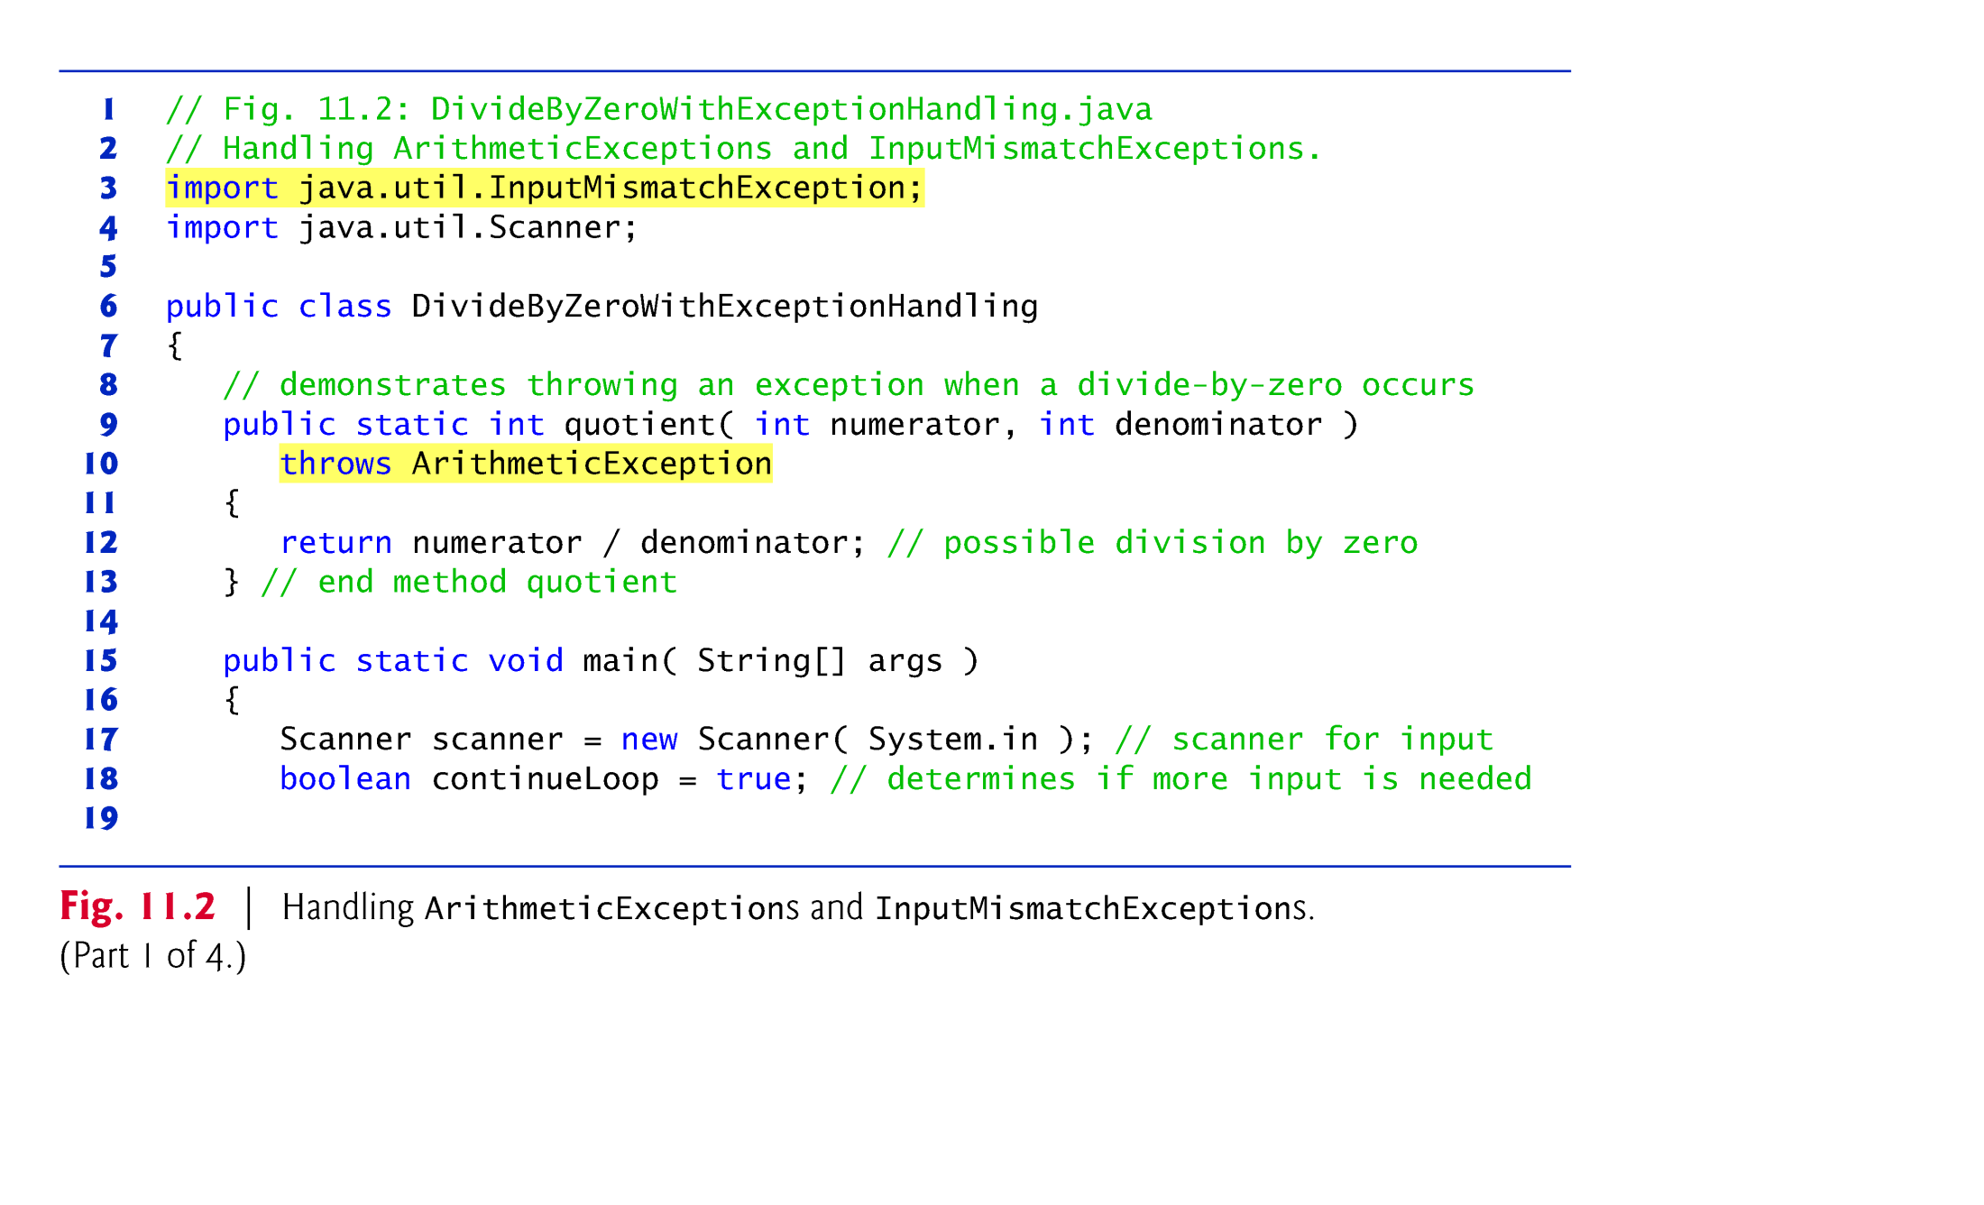

Slide 11
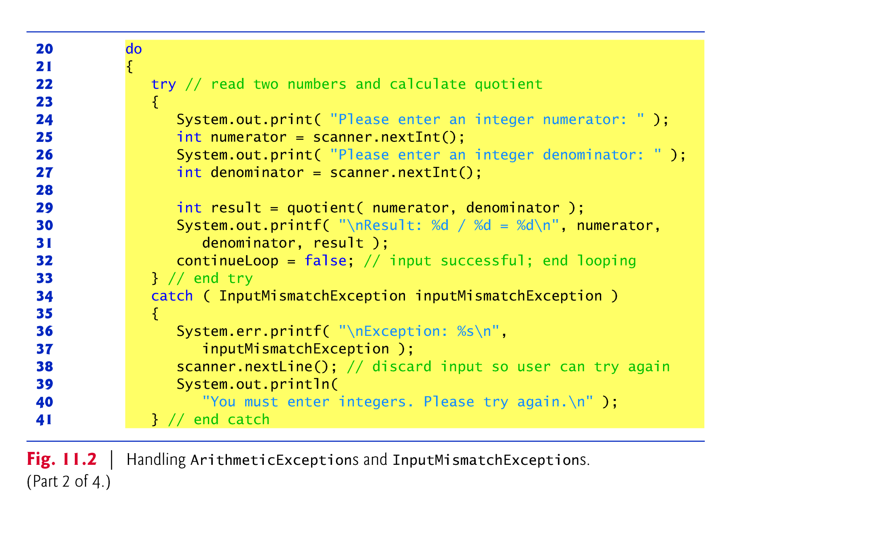

Slide 12
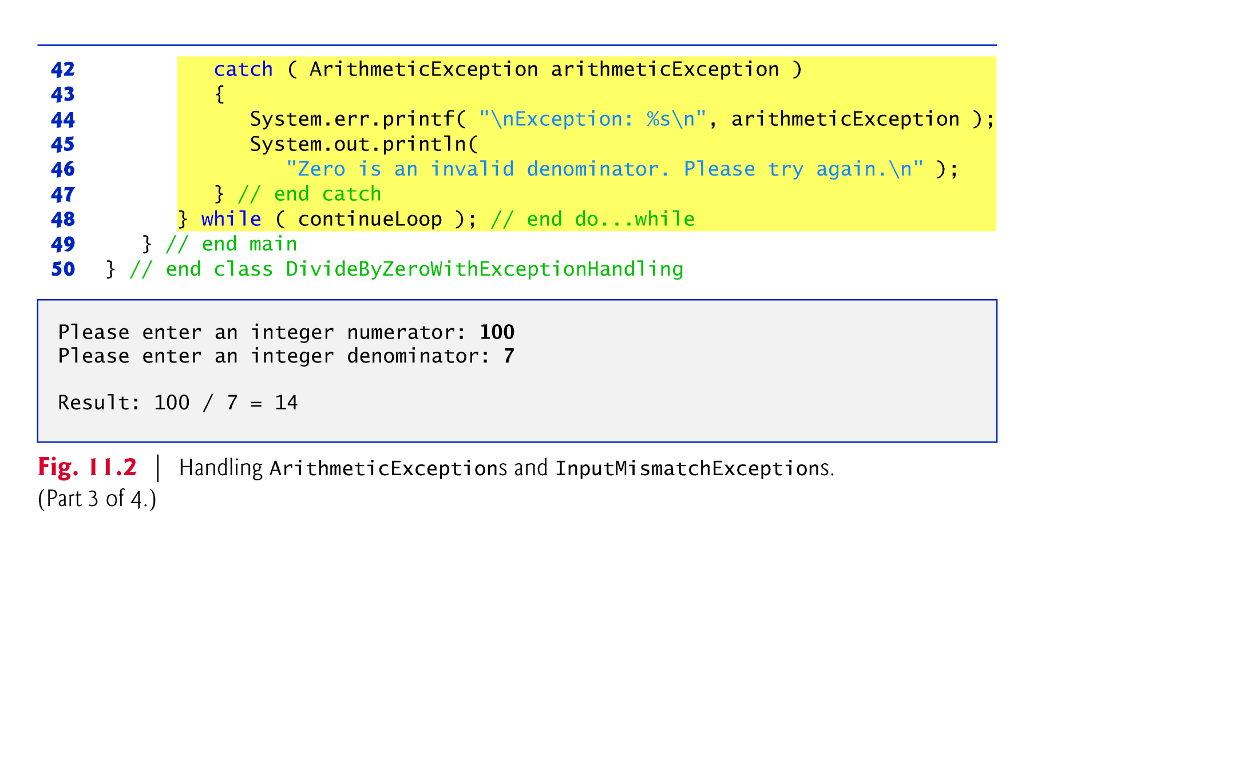

Slide 13
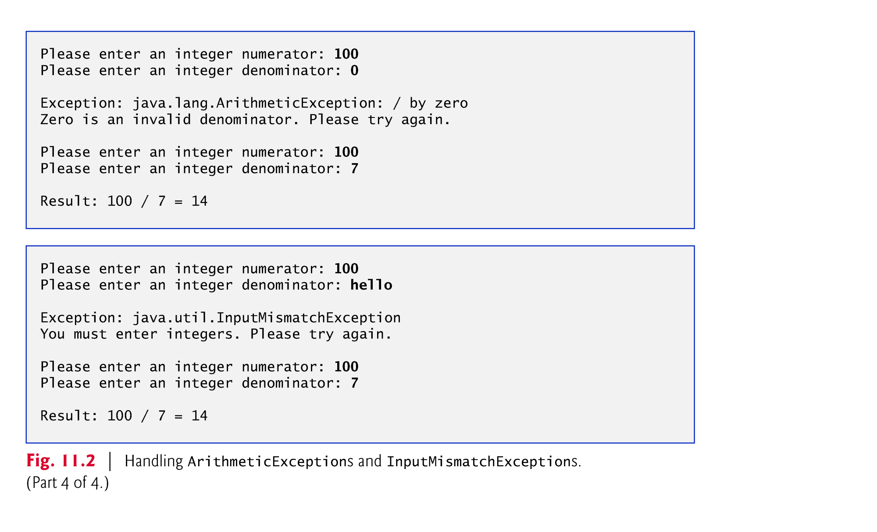

Slide 14
11.3 Example: Handling ArithmeticExceptions and InputMismatchExceptions (Cont.)
try block encloses
code that might throw an exception
code that should not execute if an exception occurs.
Consists of the keyword try followed by a block of code enclosed in curly braces.

Slide 15
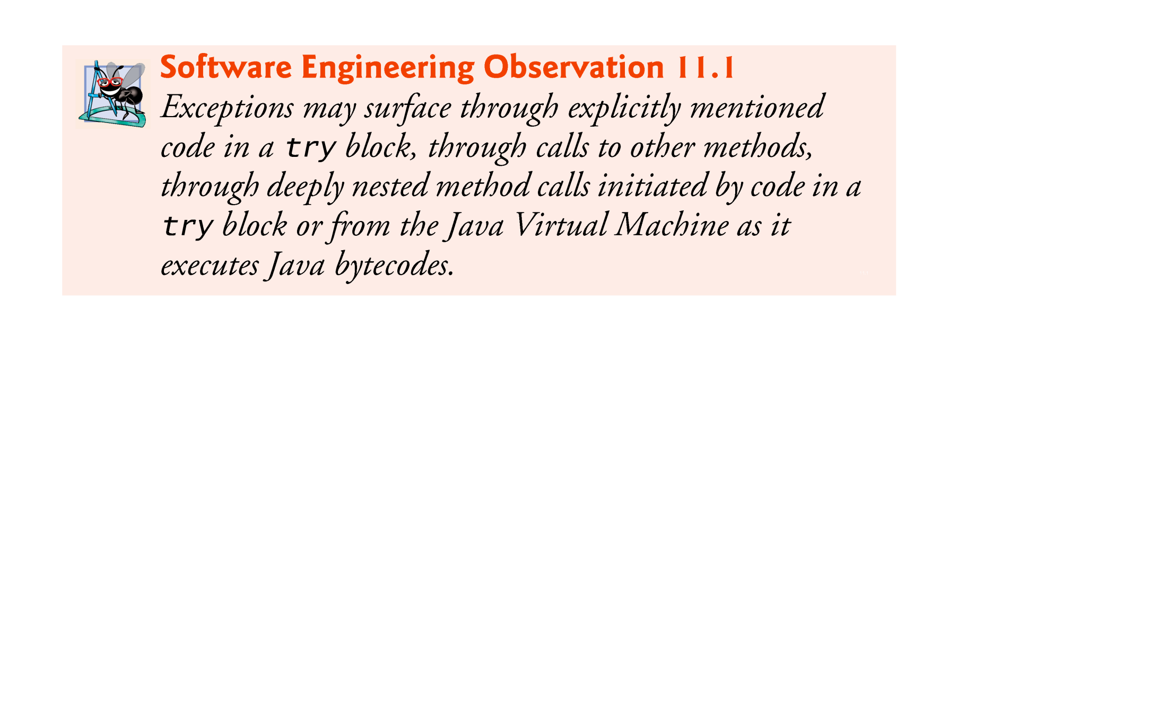

Slide 16
11.3 Example: Handling ArithmeticExceptions and InputMismatchExceptions (Cont.)
catch block (also called a catch clause or exception handler) catches and handles an exception.
Begins with the keyword catch and is followed by an exception parameter in parentheses and a block of code enclosed in curly braces.
At least one catch block or a finally block (Section 11.6) must immediately follow the try block.
The exception parameter identifies the exception type the handler can process.
The parameter’s name enables the catch block to interact with a caught exception object.

Slide 17
11.3 Example: Handling ArithmeticExceptions and InputMismatchExceptions (Cont.)
When an exception occurs in a try block, the catch block that executes is the first one whose type matches the type of the exception that occurred.
Use the System.err (standard error stream) object to output error messages.
By default, displays data to the command prompt.

Slide 18
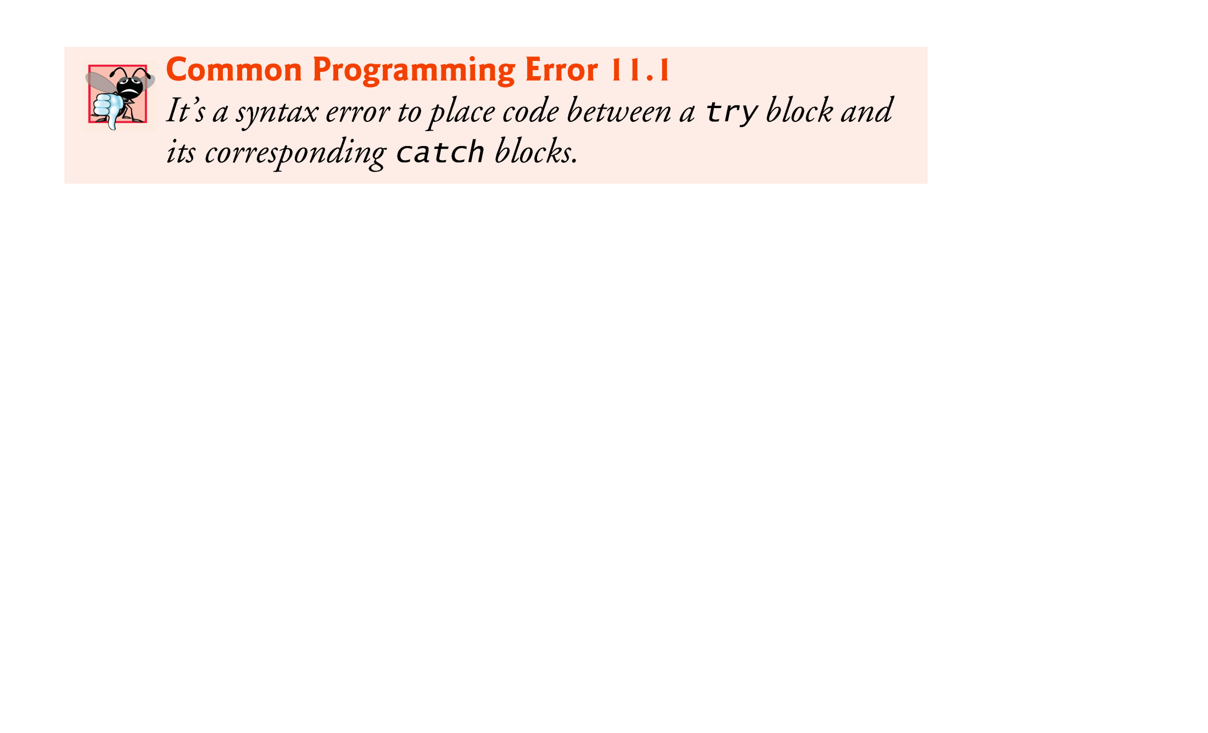

Slide 19
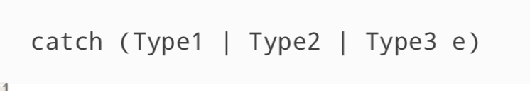
Multi-catch

Slide 20
11.3 Example: Handling ArithmeticExceptions and InputMismatchExceptions (Cont.)
Uncaught exception—one for which there are no matching catch blocks.
Java uses a multithreaded model of program execution.
Each thread is a parallel activity.
One program can have many threads.
If a program has only one thread, an uncaught exception will cause the program to terminate.
If a program has multiple threads, an uncaught exception will terminate only the thread where the exception occurred.

Slide 21
11.3 Example: Handling ArithmeticExceptions and InputMismatchExceptions (Cont.)
If no exceptions are thrown in a try block, the catch blocks are skipped and control continues with the first statement after the catch blocks
We’ll learn about another possibility when we discuss the finally block in Section 11.6.
The try block and its corresponding catch and/or finally blocks form a try statement.

Slide 22
11.3 Example: Handling ArithmeticExceptions and InputMismatchExceptions (Cont.)
When a try block terminates, local variables declared in the block go out of scope.
The local variables of a try block are not accessible in the corresponding catch blocks.
When a catch block terminates, local variables declared within the catch block (including the exception parameter) also go out of scope.
Any remaining catch blocks in the try statement are ignored, and execution resumes at the first line of code after the try…catch sequence.
A finally block, if one is present.

Slide 23
11.3 Example: Handling ArithmeticExceptions and InputMismatchExceptions (Cont.)
throws clause—specifies the exceptions a method throws.
Appears after the method’s parameter list and before the method’s body.
Contains a comma-separated list of the exceptions that the method will throw if various problems occur.
May be thrown by statements in the method’s body or by methods called from the body.
Method can throw exceptions of the classes listed in its throws clause or of their subclasses.
Clients of a method with a throws clause are thus informed that the method may throw exceptions.

Slide 24
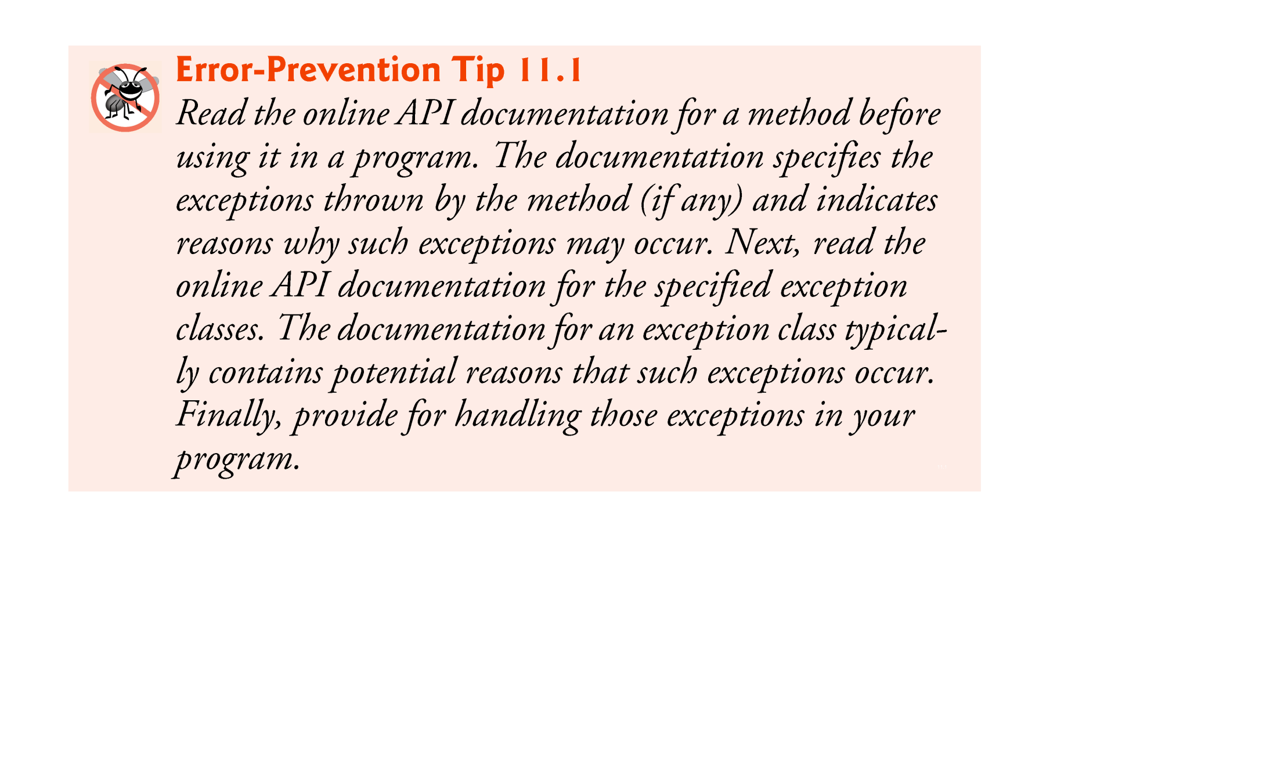

Slide 25
11.3 Example: Handling ArithmeticExceptions and InputMismatchExceptions (Cont.)
When a method throws an exception, the method terminates and does not return a value, and its local variables go out of scope.
If the local variables were references to objects and there were no other references to those objects, the objects would be available for garbage collection.

Slide 26
11.4 When to Use Exception Handling
Exception handling is designed to process synchronous errors, which occur when a statement executes.
Common examples in this book:
out-of-range array indices
arithmetic overflow
division by zero
invalid method parameters
thread interruption
unsuccessful memory allocation

Slide 27
11.4 When to Use Exception Handling (Cont.)
Exception handling is not designed to process problems associated with asynchronous events
disk I/O completions
network message arrivals
mouse clicks and keystrokes

Slide 28
11.5 Java Exception Hierarchy
Exception classes inherit directly or indirectly from class Exception, forming an inheritance hierarchy.
Can extend this hierarchy with your own exception classes.
Figure 11.3 shows a small portion of the inheritance hierarchy for class Throwable (a subclass of Object), which is the superclass of class Exception.
Only Throwable objects can be used with the exception-handling mechanism.
Class Throwable has two subclasses: Exception and Error.

Slide 29
11.5 Java Exception Hierarchy (Cont.)
Class Exception and its subclasses represent exceptional situations that can occur in a Java program
These can be caught and handled by the application.
Class Error and its subclasses represent abnormal situations that happen in the JVM.
Errors happen infrequently.
These should not be caught by applications.
Applications usually cannot recover from Errors.

Slide 30
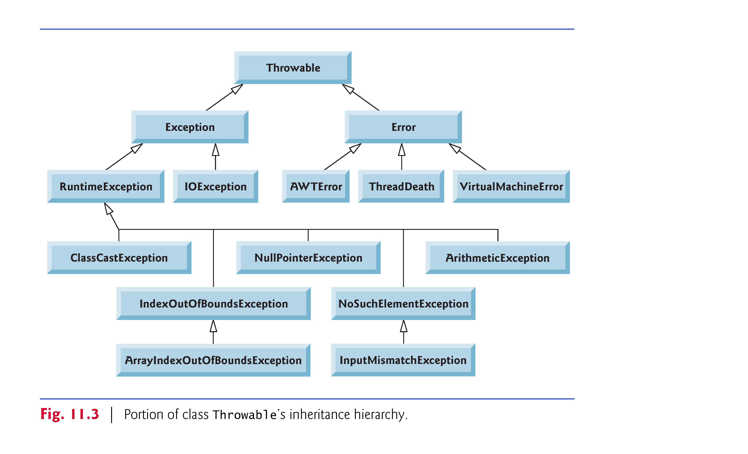

Slide 31
11.5 Java Exception Hierarchy (Cont.)
Checked exceptions vs. unchecked exceptions.
Compiler enforces a catch-or-declare requirement for checked exceptions.
An exception’s type determines whether it is checked or unchecked.
Direct or indirect subclasses of class RuntimeException (package java.lang) are unchecked exceptions.
Typically caused by defects in your program’s code (e.g., ArrayIndexOutOfBoundsExceptions).
Subclasses of Exception but not RuntimeException are checked exceptions.
Caused by conditions that are not in the control of the program—e.g., in file processing, the program can’t open a file because the file does not exist.

Slide 32
11.5 Java Exception Hierarchy (Cont.)
Classes that inherit from class Error are considered to be unchecked.

Slide 33
11.5 Java Exception Hierarchy (Cont.)
Checked Exception:
The compiler checks each method call and method declaration to determine whether the method throws checked exceptions.
If so, the compiler verifies that the checked exception is caught or is declared in a throws clause.
throws clause specifies the exceptions a method throws.
Such exceptions are typically not caught in the method’s body.
If the catch-or-declare requirement is not satisfied, the compiler will issue an error message indicating that the exception must be caught or declared.

Slide 34
11.5 Java Exception Hierarchy (Cont.)
unchecked exception :
The compiler does not check the code to determine whether an unchecked exception is caught or declared.
These typically can be prevented by proper coding.
For example, an ArithmeticException can be avoided if a method ensures that the denominator is not zero before attempting to perform the division.
Unchecked exceptions are not required to be listed in a method’s throws clause.
Even if they are, it’s not required that such exceptions be caught by an application.

Slide 35
11.5 Java Exception Hierarchy (Cont.)
A catch parameter of a superclass-type can also catch all of that exception type’s subclass types.
You can also catch each subclass type individually if those exceptions require different processing.

Slide 36
11.5 Java Exception Hierarchy (Cont.)
If there multiple catch blocks match a particular exception type, only the first matching catch block executes.
It’s a compilation error to catch the exact same type in two different catch blocks associated with a particular try block.

Slide 37
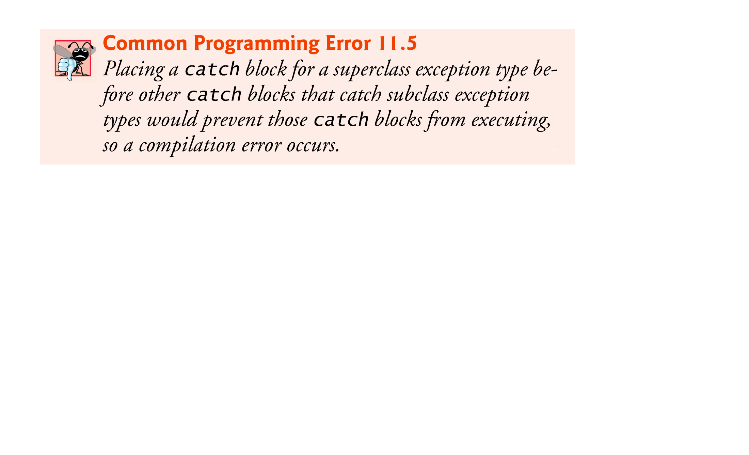

Slide 38
11.6 finally Block
The finally block is used for resource deallocation.
Placed after the last catch block.
finally block will execute whether or not an exception is thrown in the corresponding try block.

Slide 39
11.6 finally Block (Cont.)
finally block will execute if a try block exits by using a return, break or continue statement or simply by reaching its closing right brace.
finally block will not execute if the application terminates immediately by calling method System.exit.
ReturnFinallyTest.java
TestException.java

Slide 40
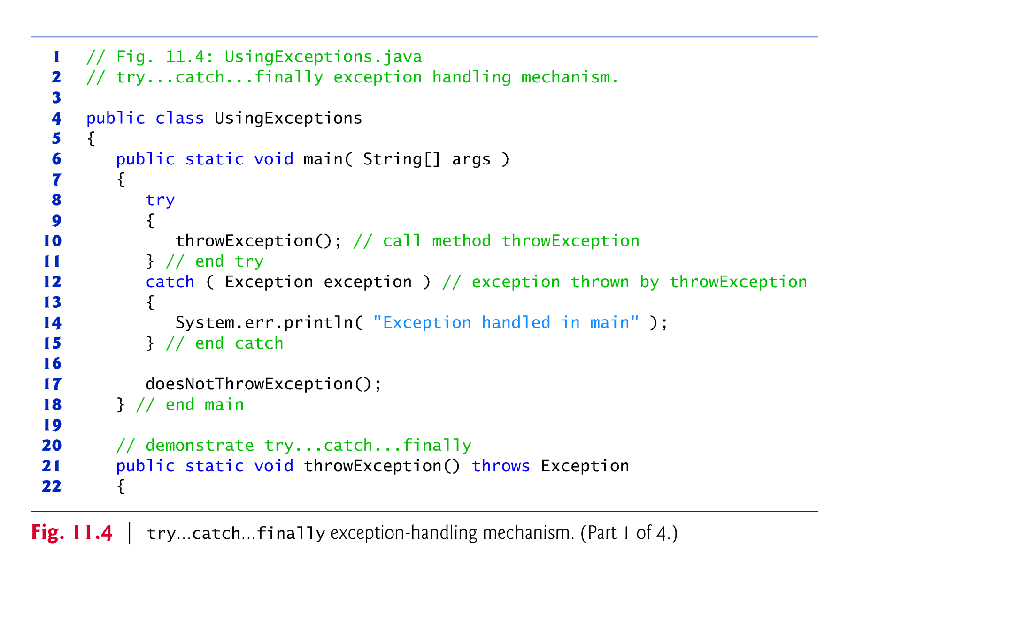

Slide 41
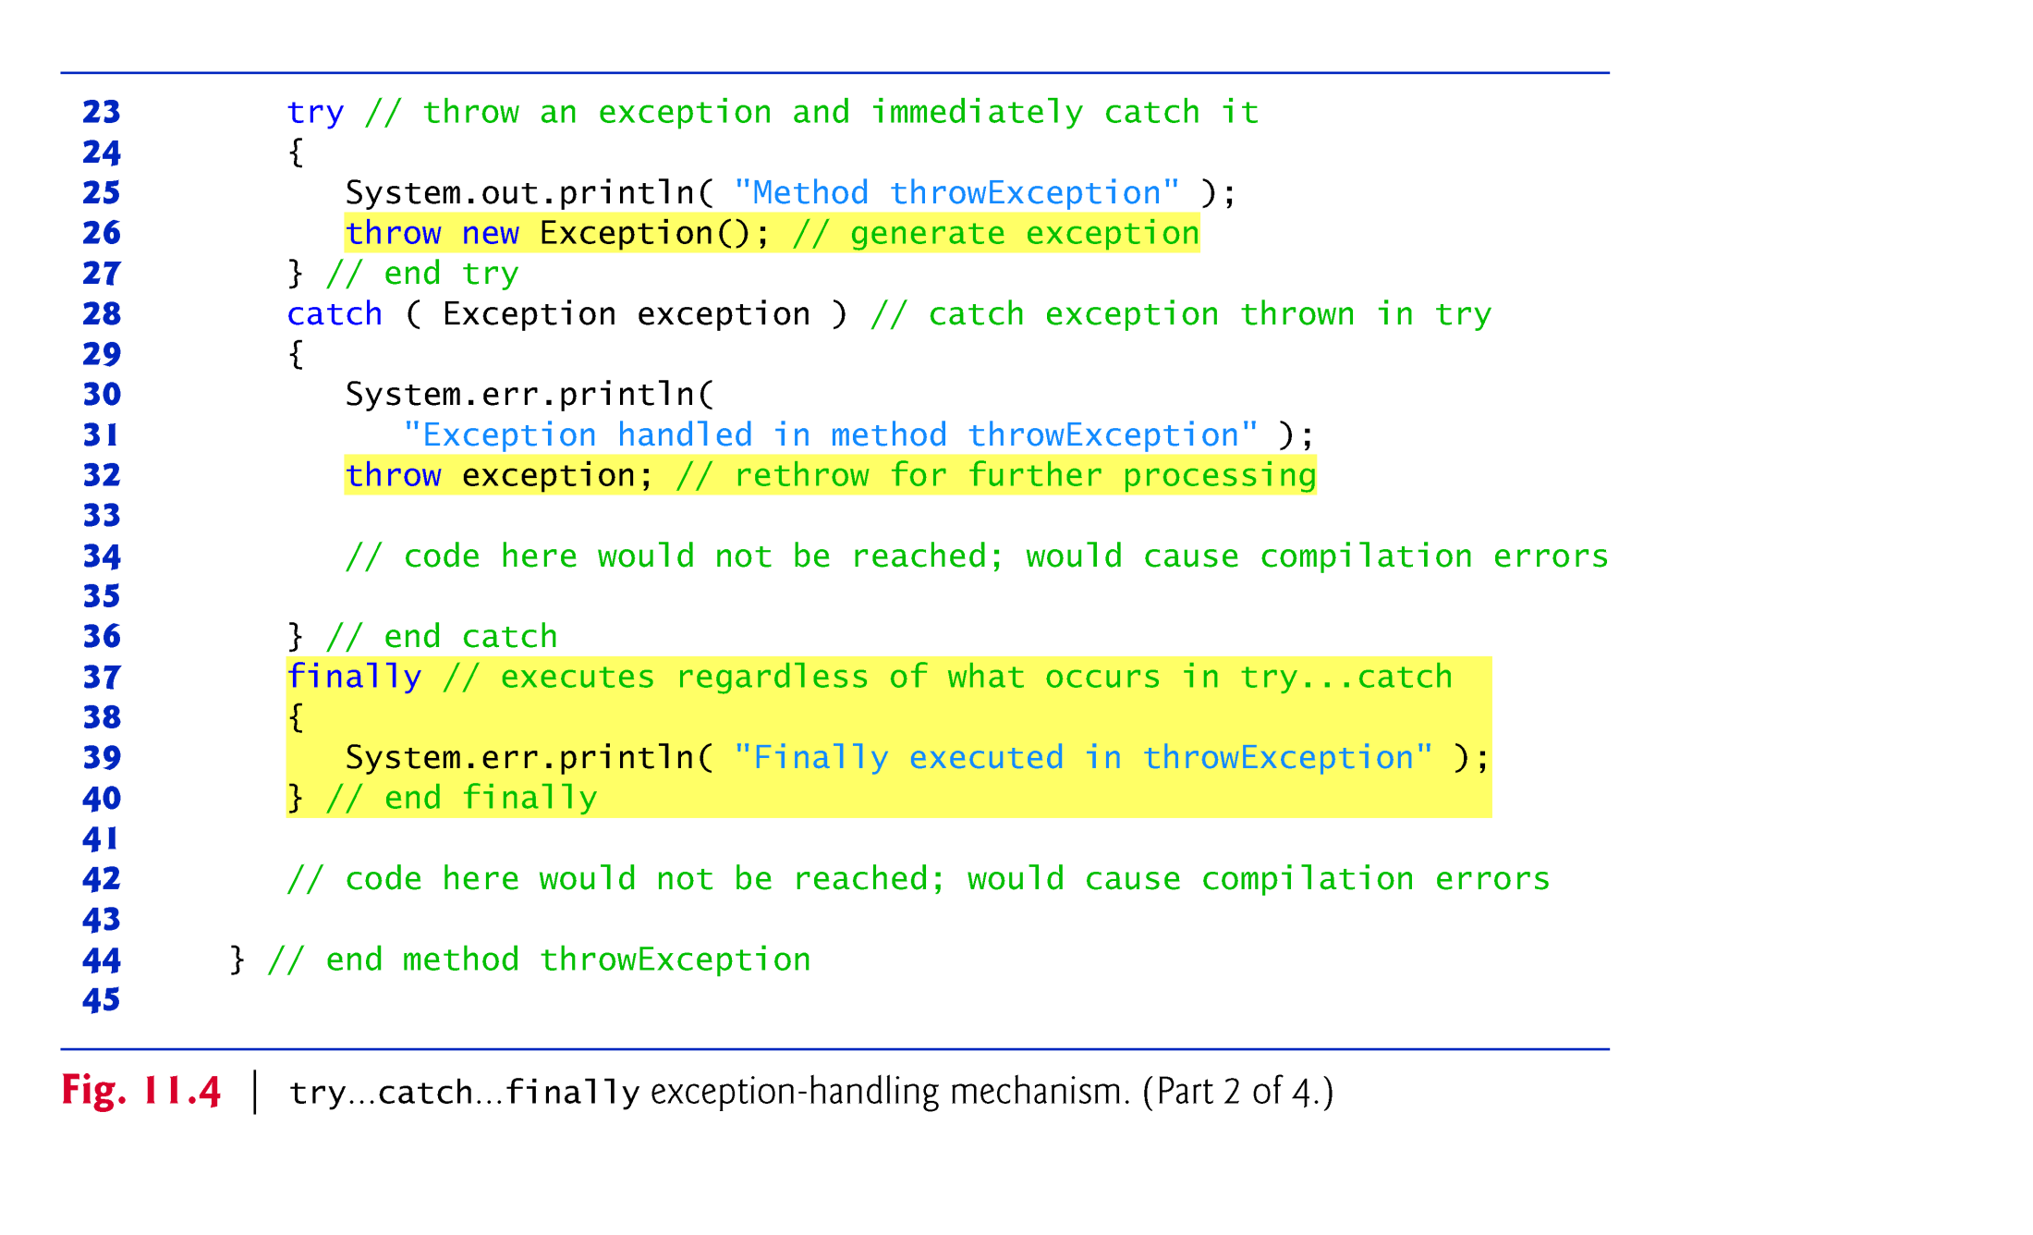

Slide 42
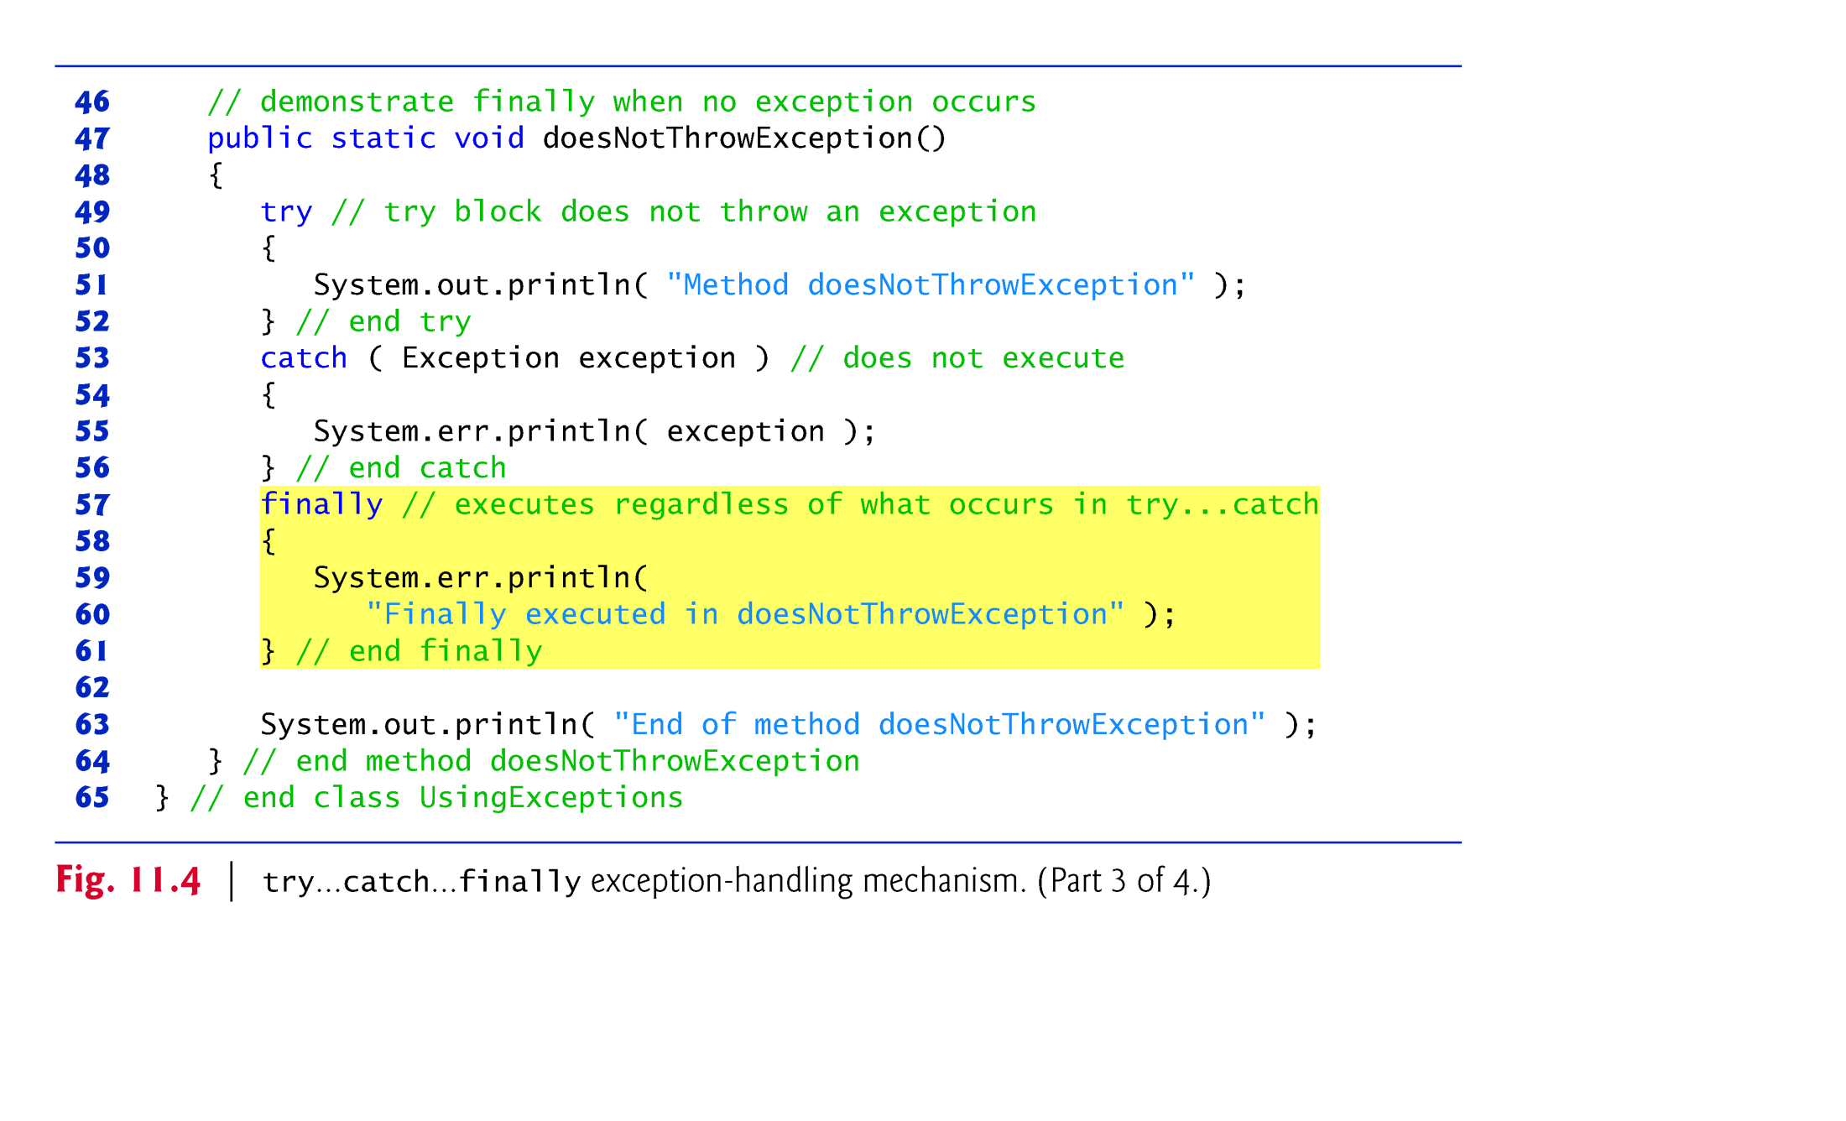

Slide 43
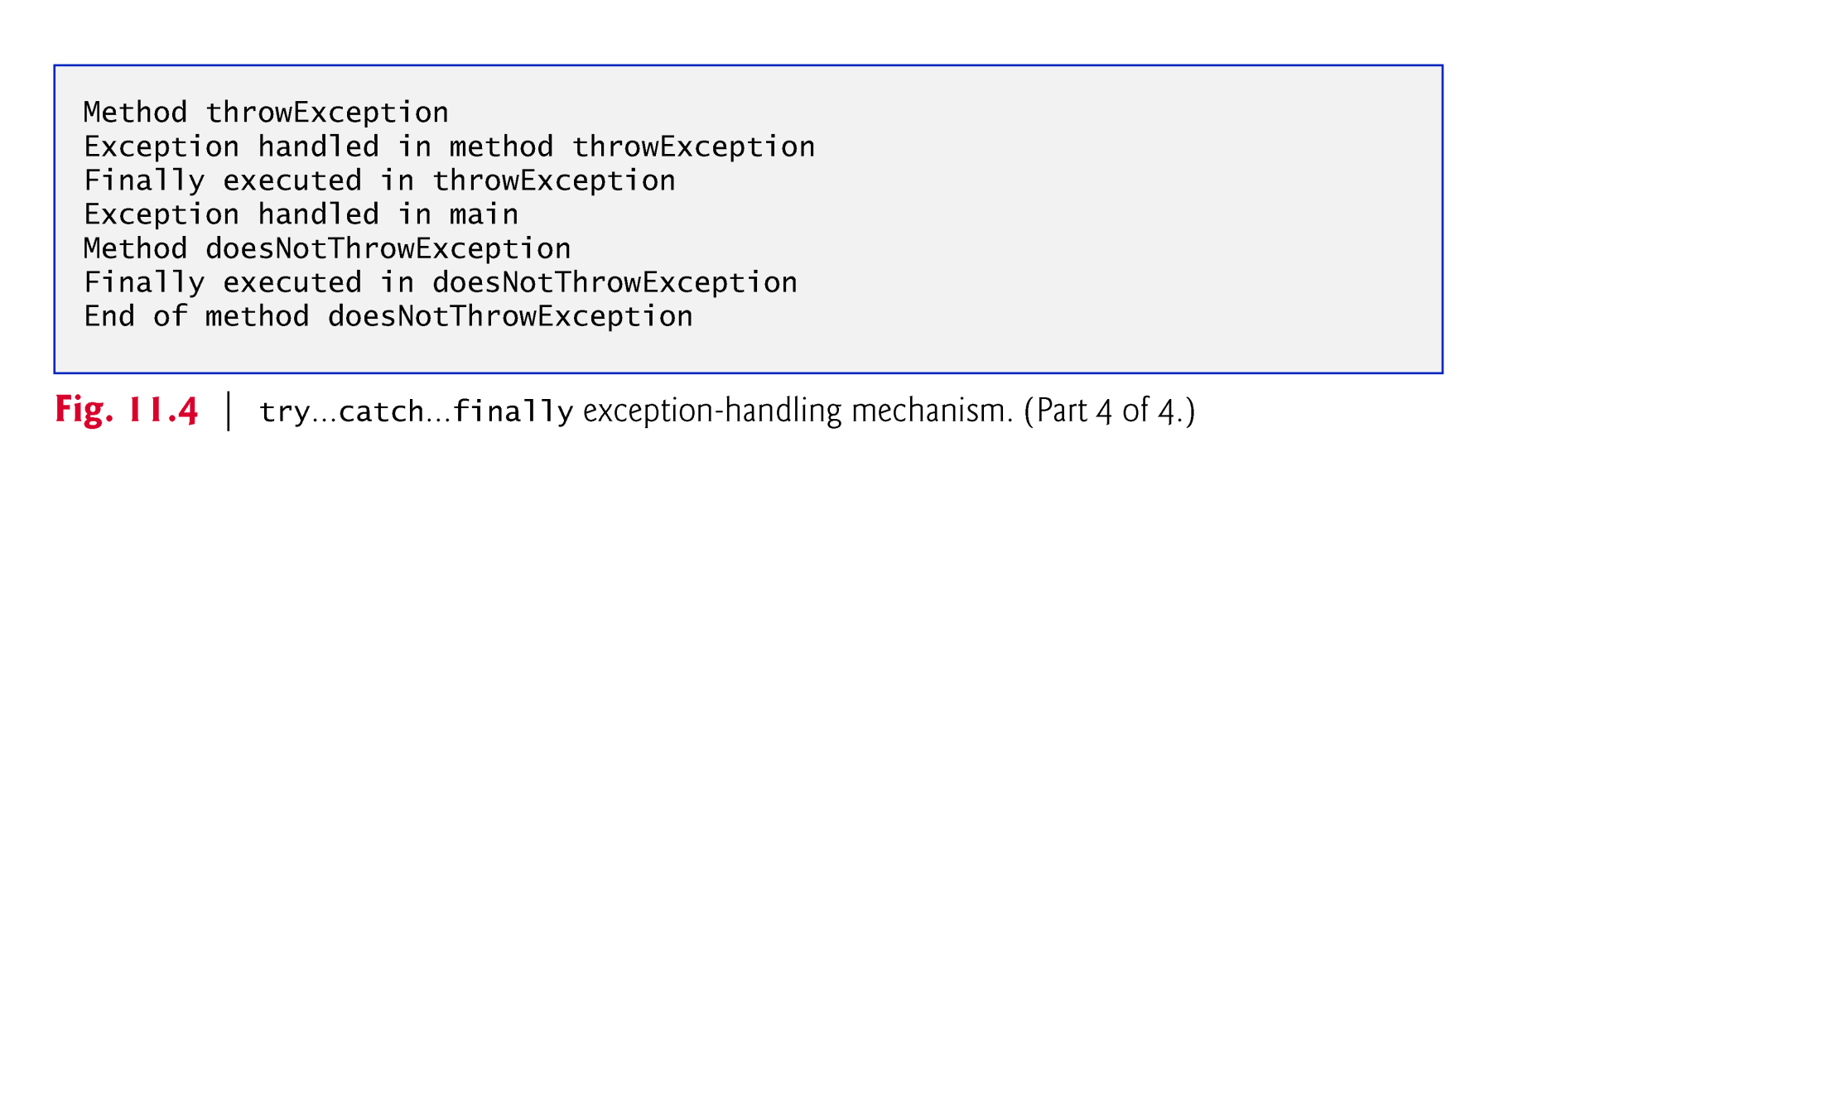

Slide 44
11.6 finally Block (Cont.)
throw statement—indicates that an exception has occurred.
Used to throw exceptions.
Indicates to client code that an error has occurred.
Specifies an object to be thrown.
The operand of a throw can be of any class derived from class Throwable.

Slide 45
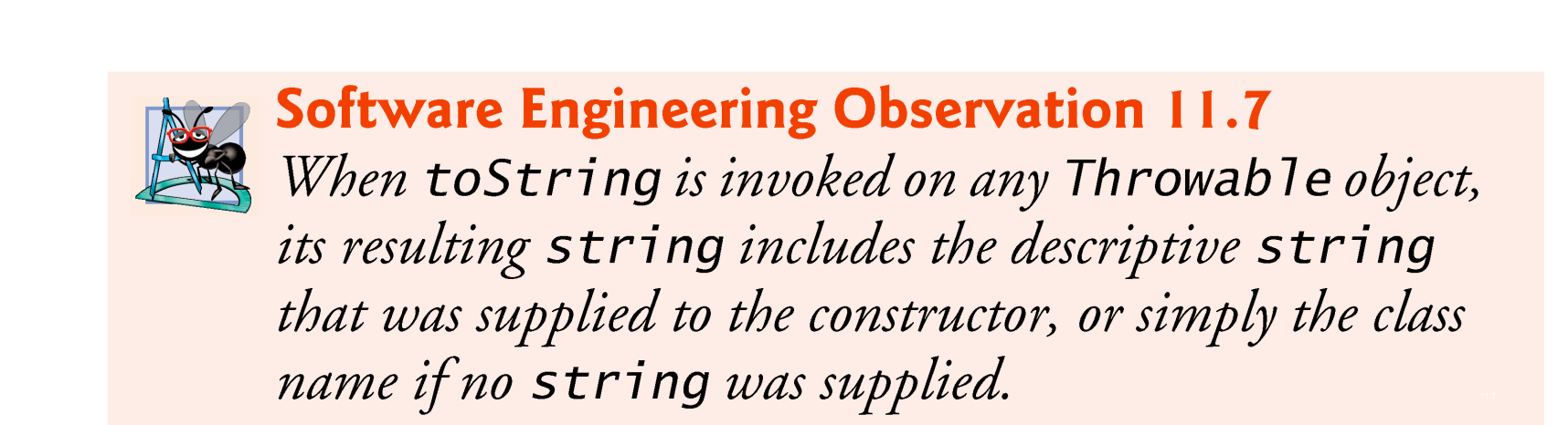

Slide 46


Slide 47
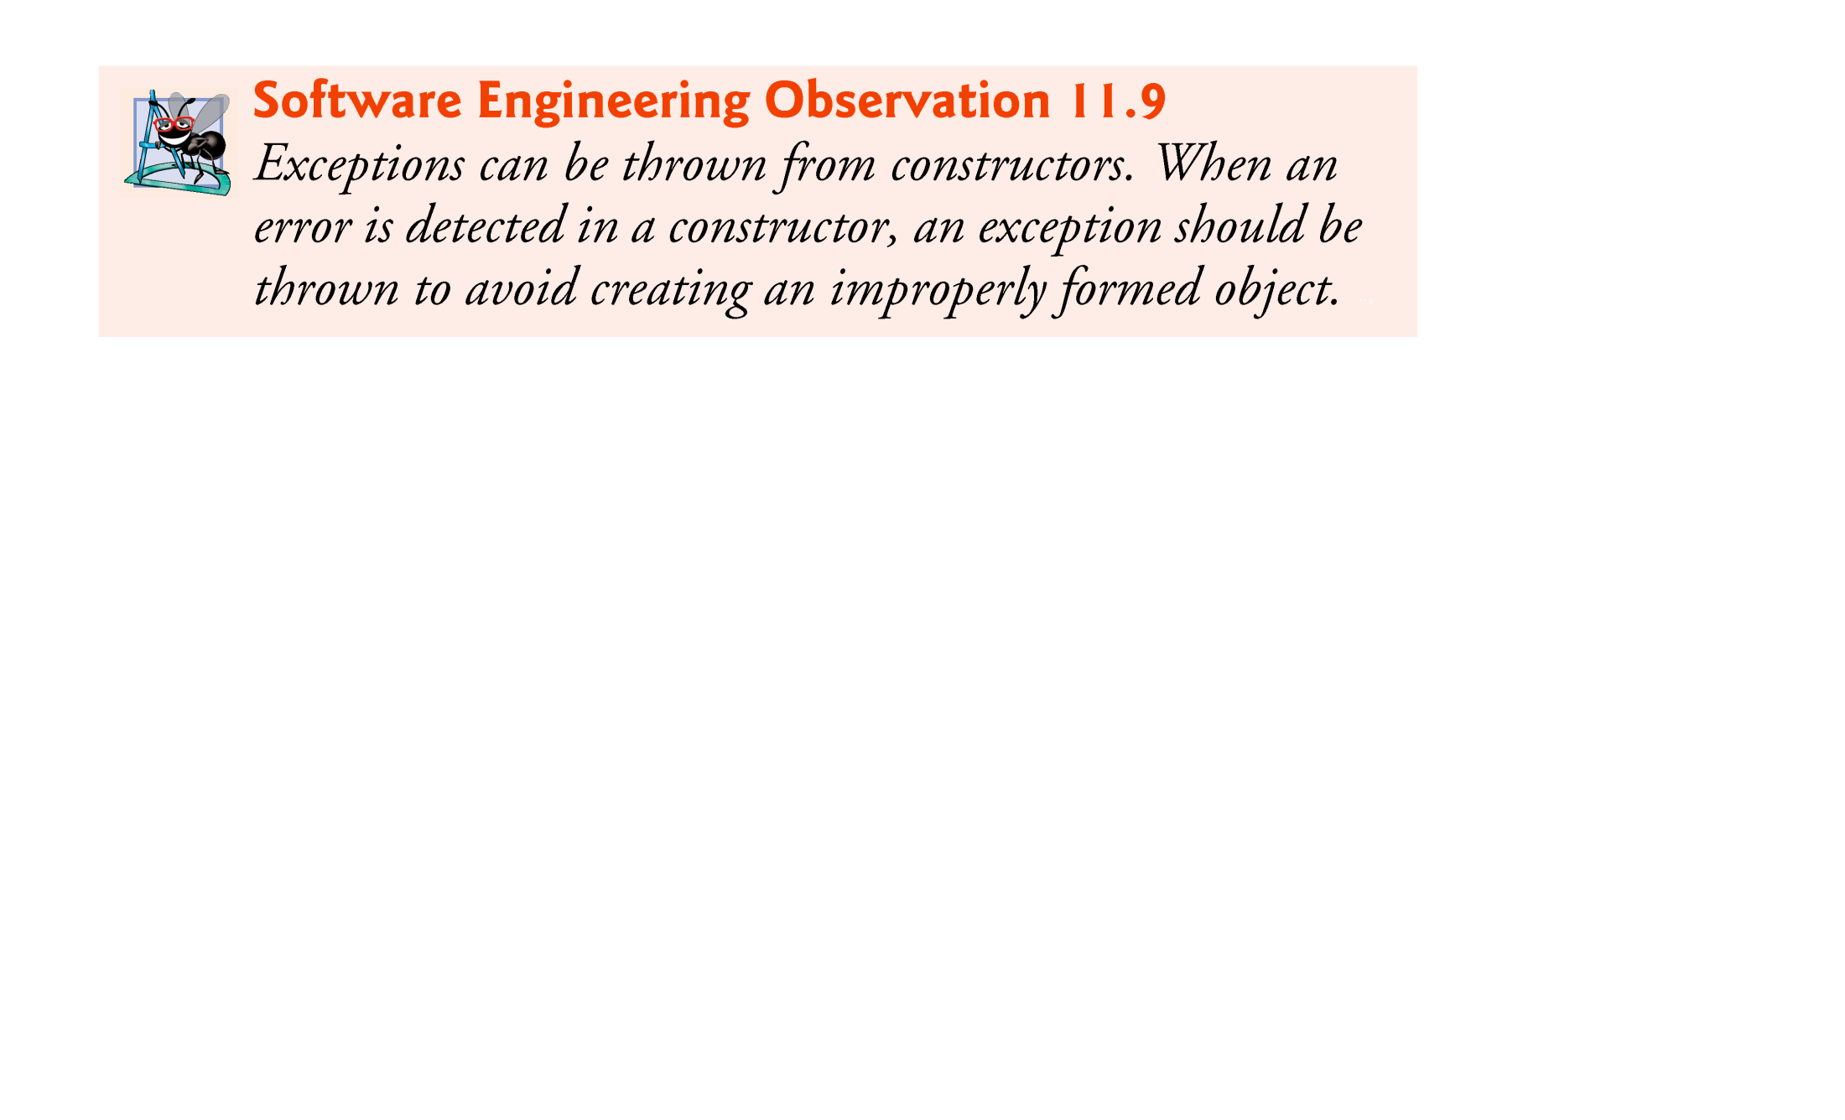

Slide 48
11.6 finally Block (Cont.)
Rethrow an exception
Done when a catch block, cannot process that exception or can only partially process it.
Defers the exception handling (or perhaps a portion of it) to another catch block associated with an outer try statement.
Rethrow by using the throw keyword, followed by a reference to the exception object that was just caught.
When a rethrow occurs, the next enclosing try block detects the exception, and that try block’s catch blocks attempt to handle it.

Slide 49
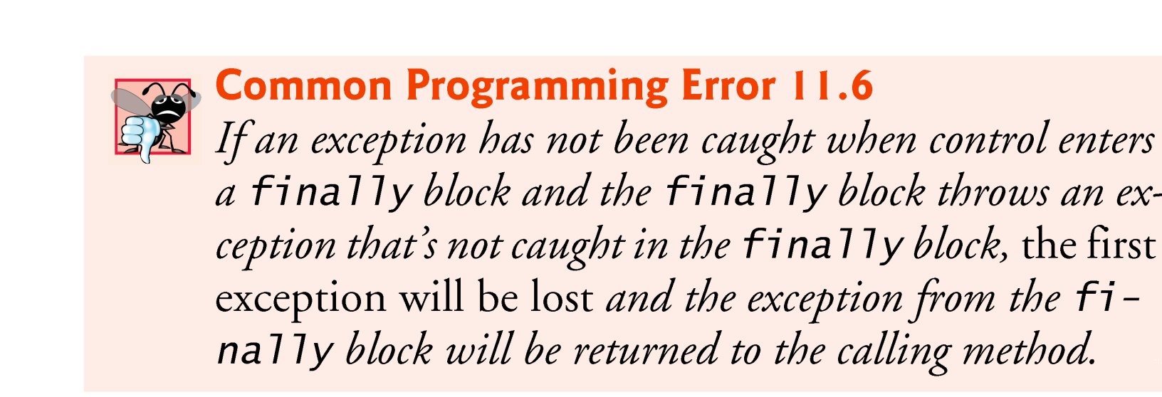

Slide 50
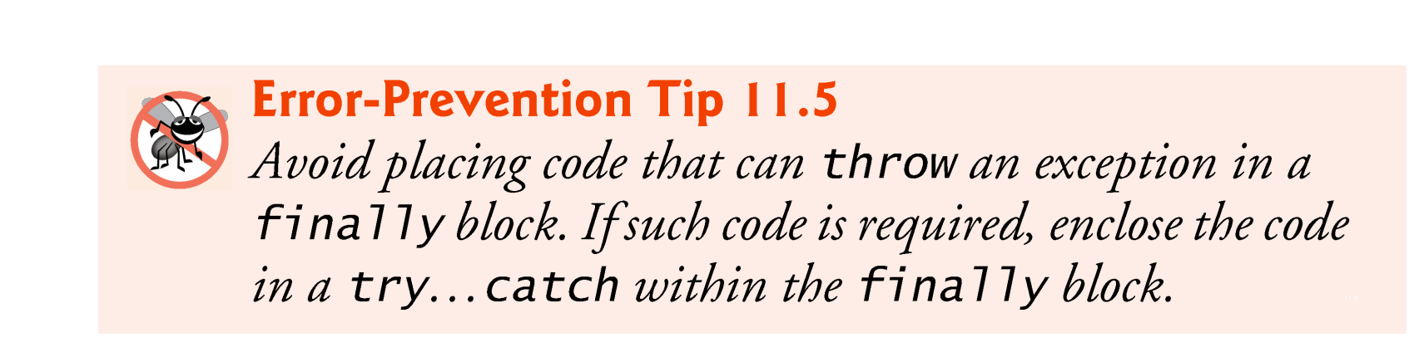

Slide 51
11.7 Stack Unwinding and Obtaining Information from an Exception Object
Stack unwinding—When an exception is thrown but not caught in a particular scope, the method-call stack is “unwound”
An attempt is made to catch the exception in the next outer try block.
All local variables in the unwound method go out of scope and control returns to the statement that originally invoked that method.
If a try block encloses that statement, an attempt is made to catch the exception.
If a try block does not enclose that statement or if the exception is not caught, stack unwinding occurs again.

Slide 52
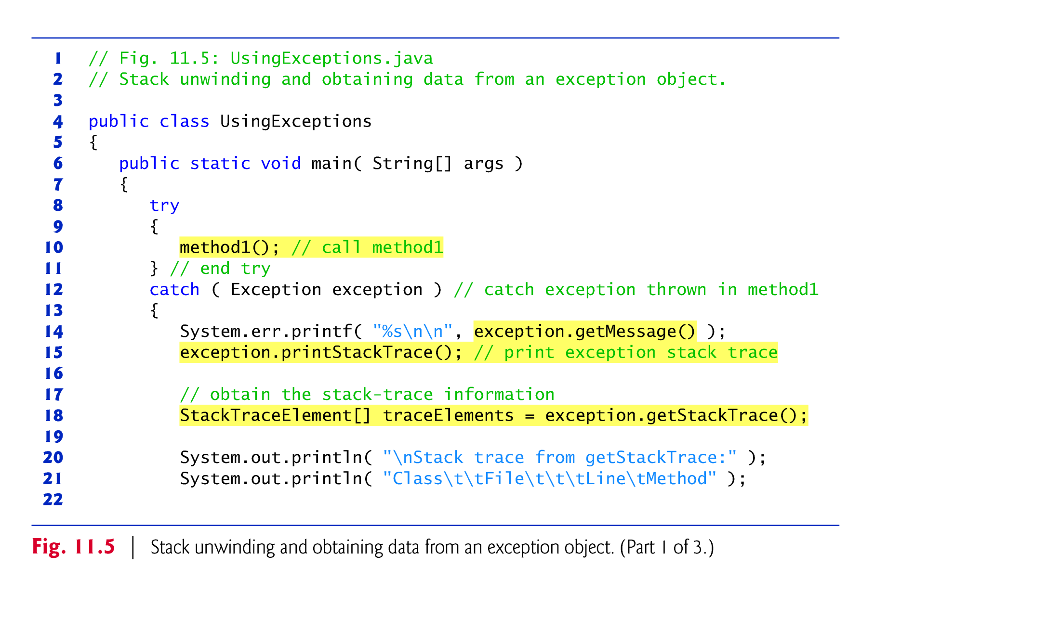

Slide 53
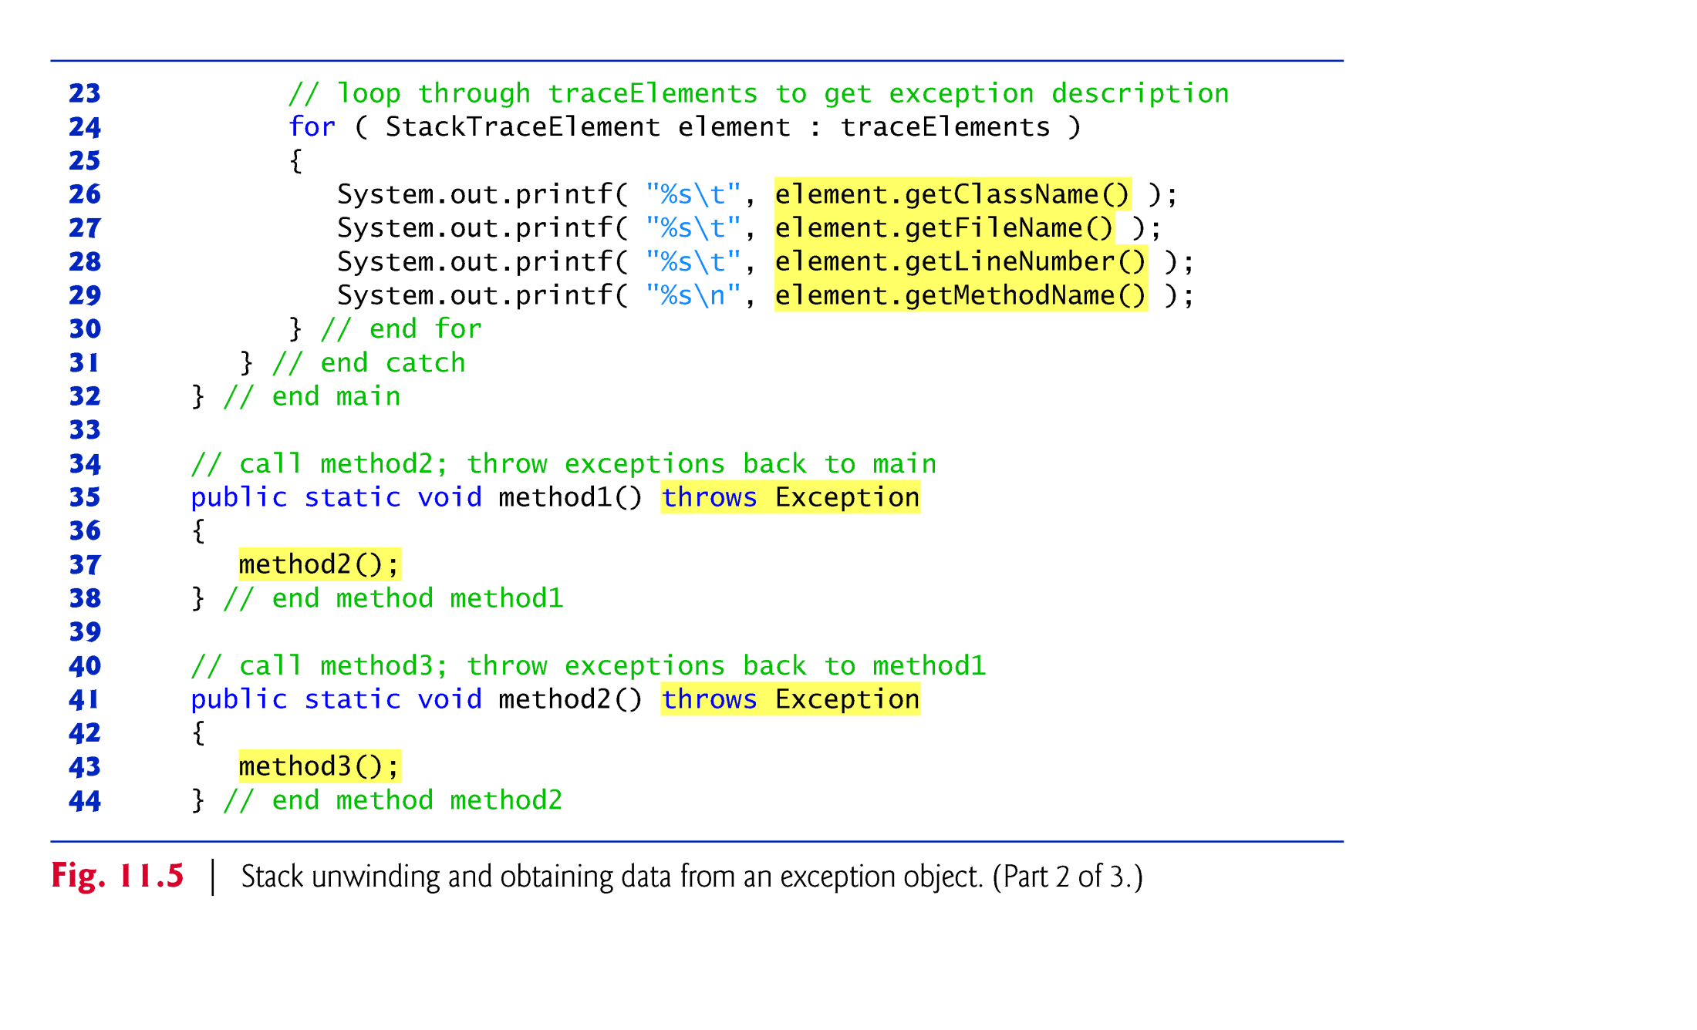

Slide 54
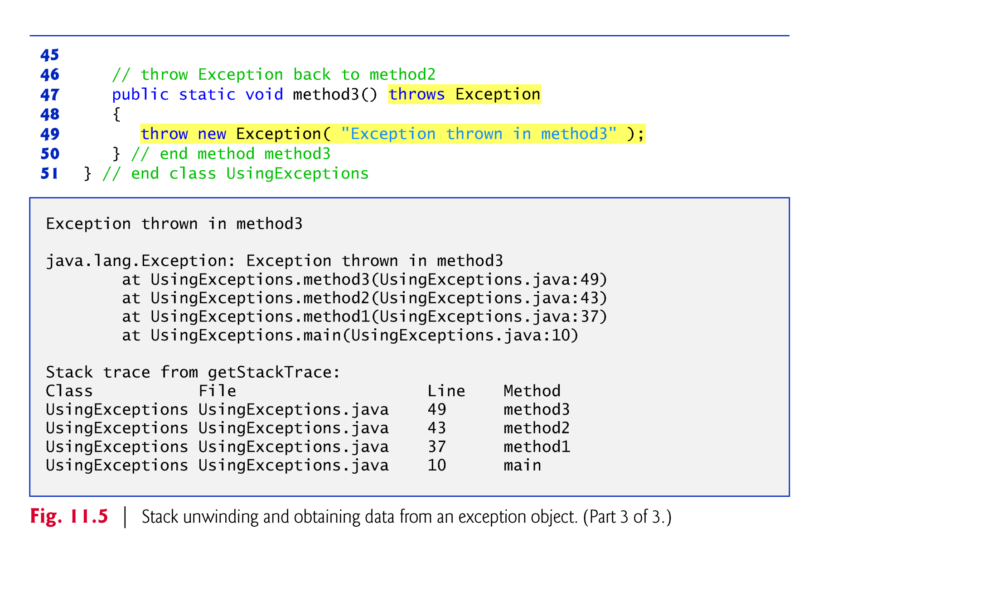

Slide 55
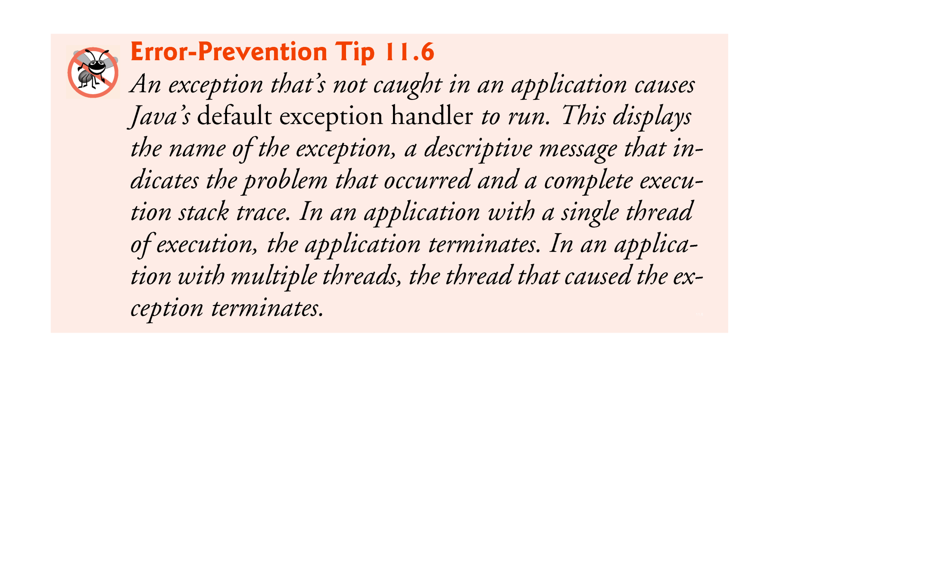

Slide 56


Slide 57
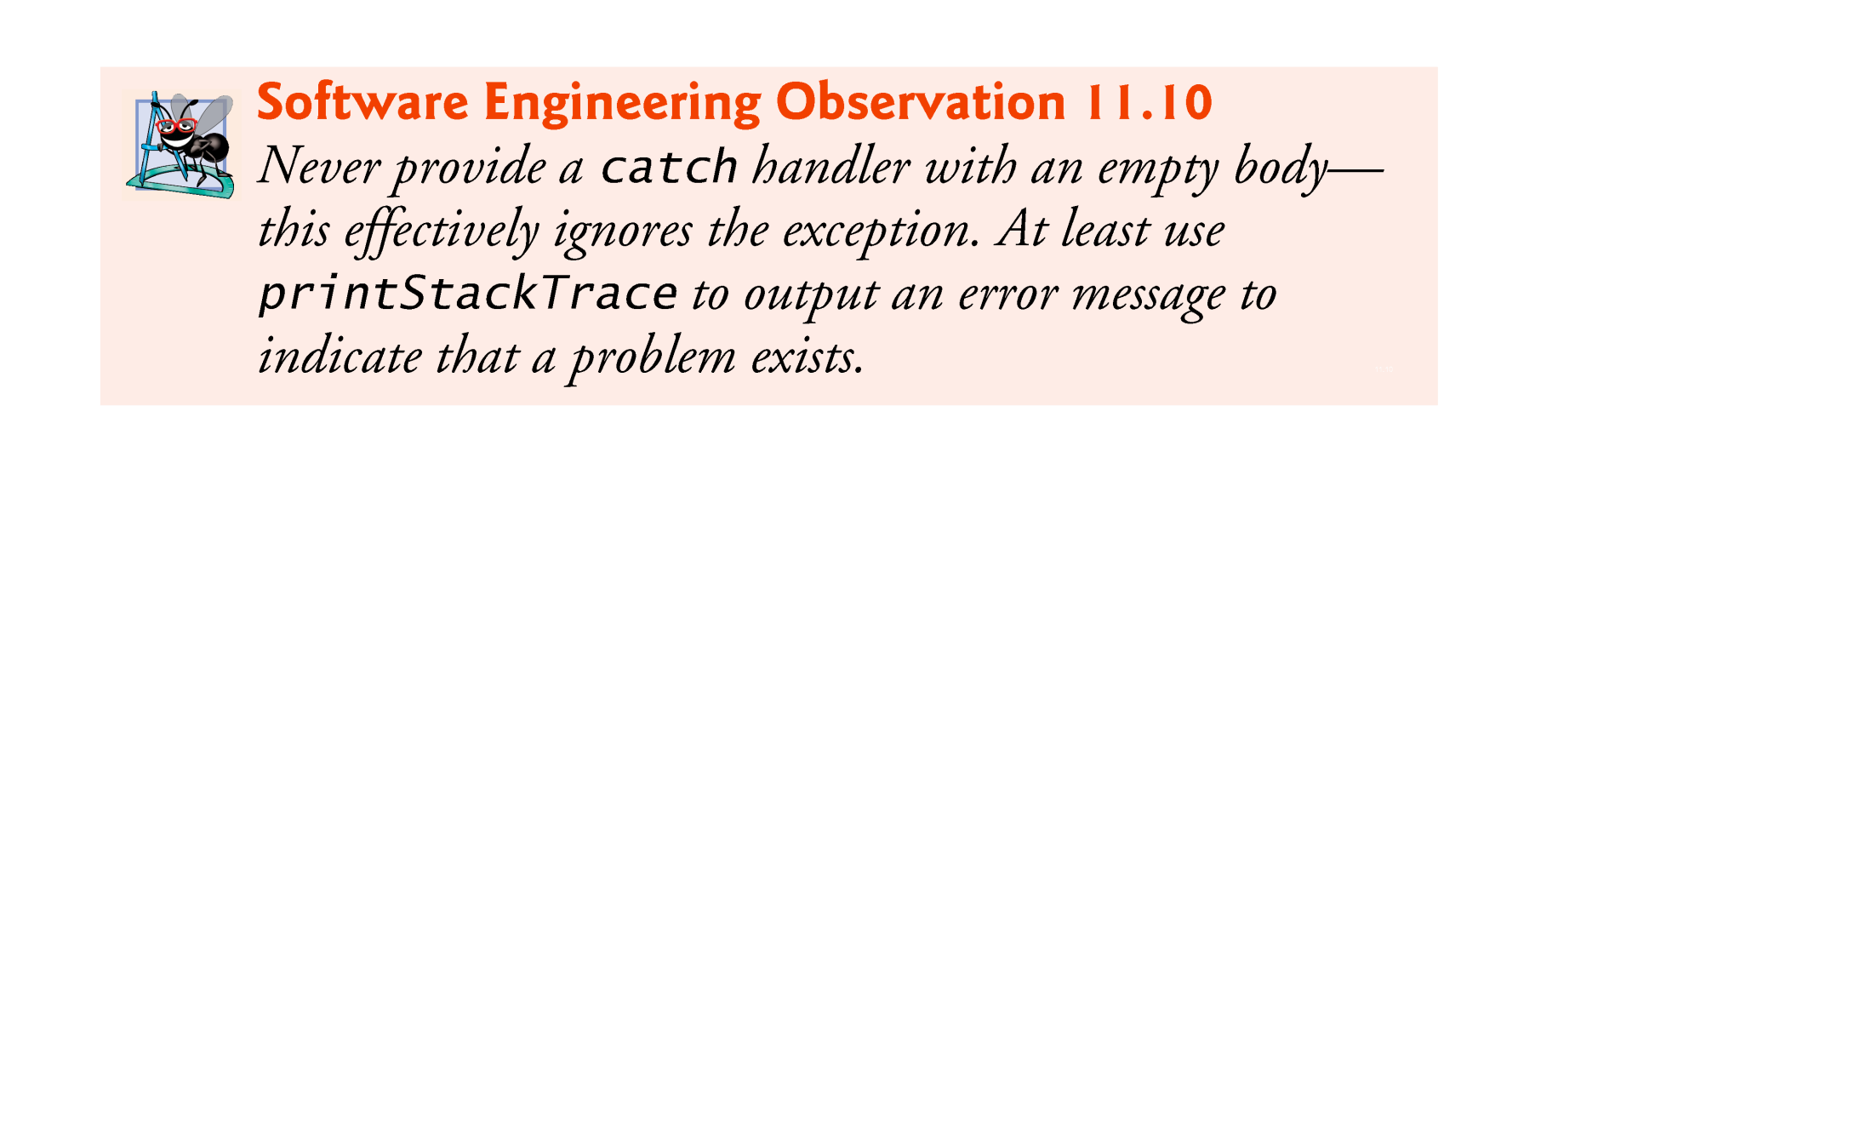

Slide 58
11.8 Chained Exceptions
Sometimes a method responds to an exception by throwing a different exception type that is specific to the current application.
If a catch block throws a new exception, the original exception’s information and stack trace are lost.
Chained exceptions enable an exception object to maintain the complete stack-trace information from the original exception.

Slide 59
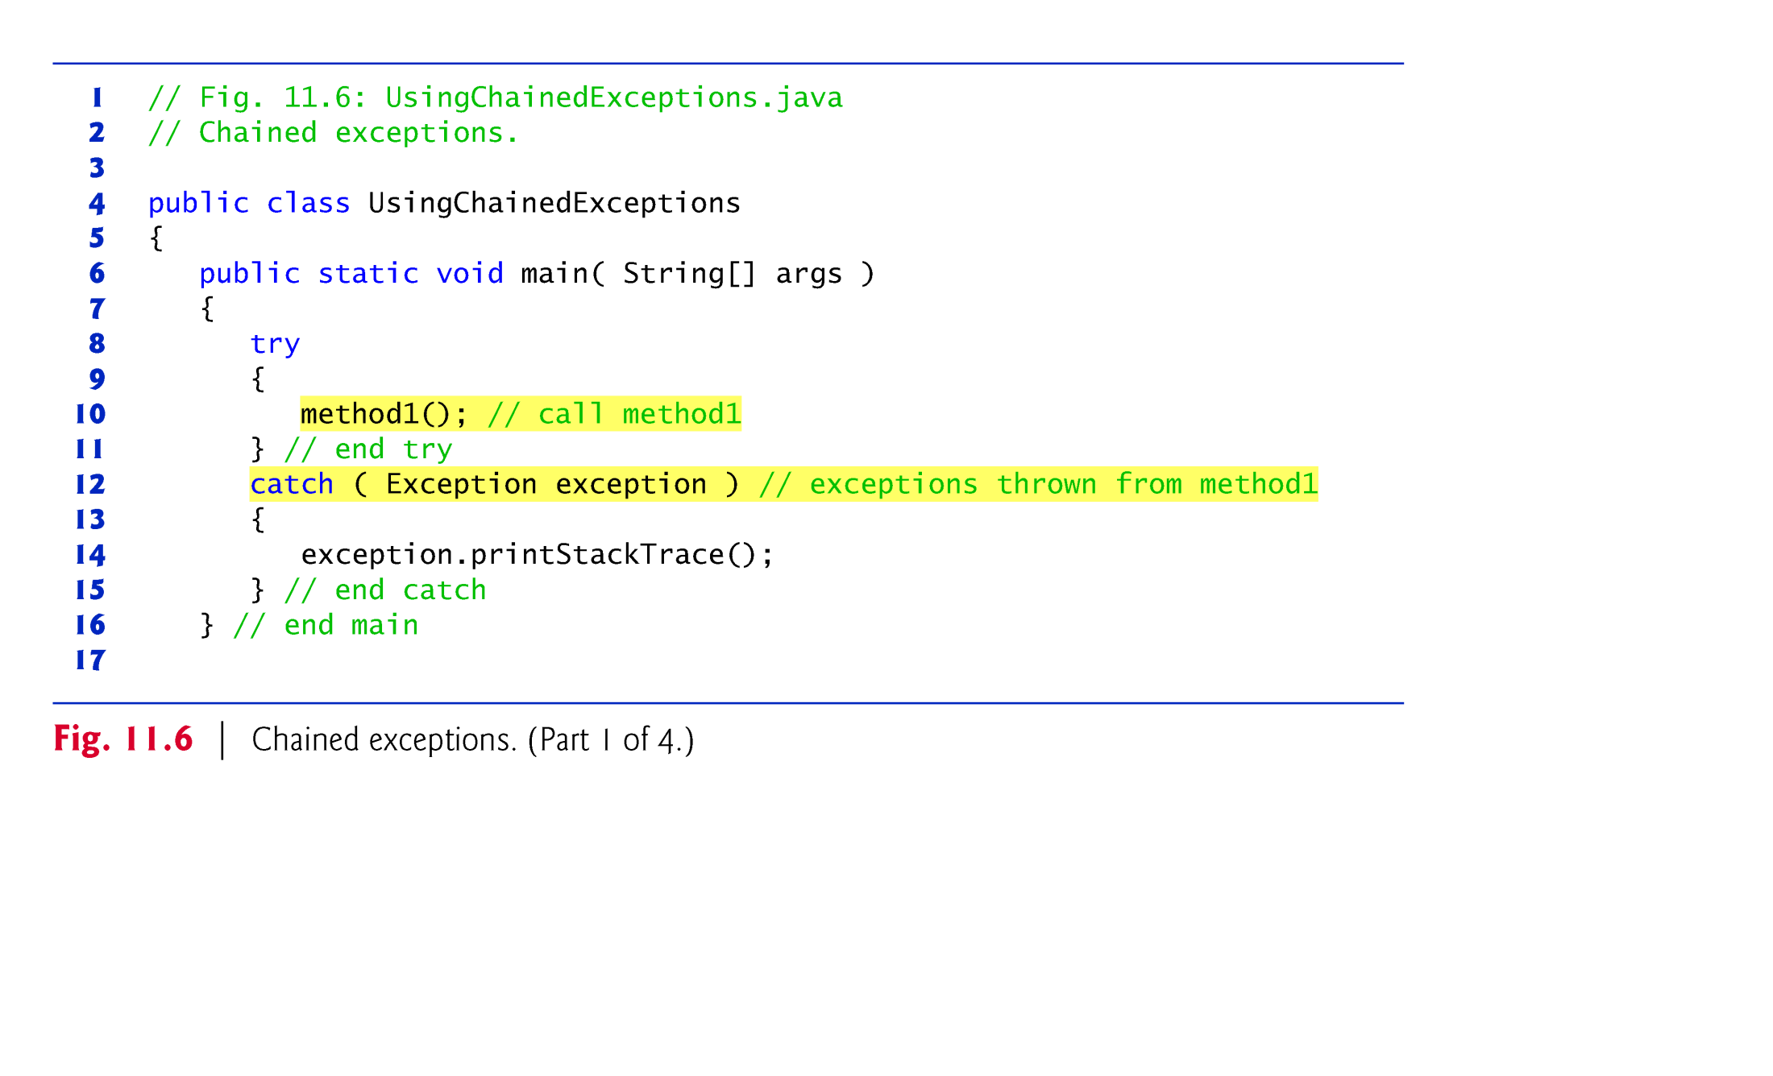

Slide 60
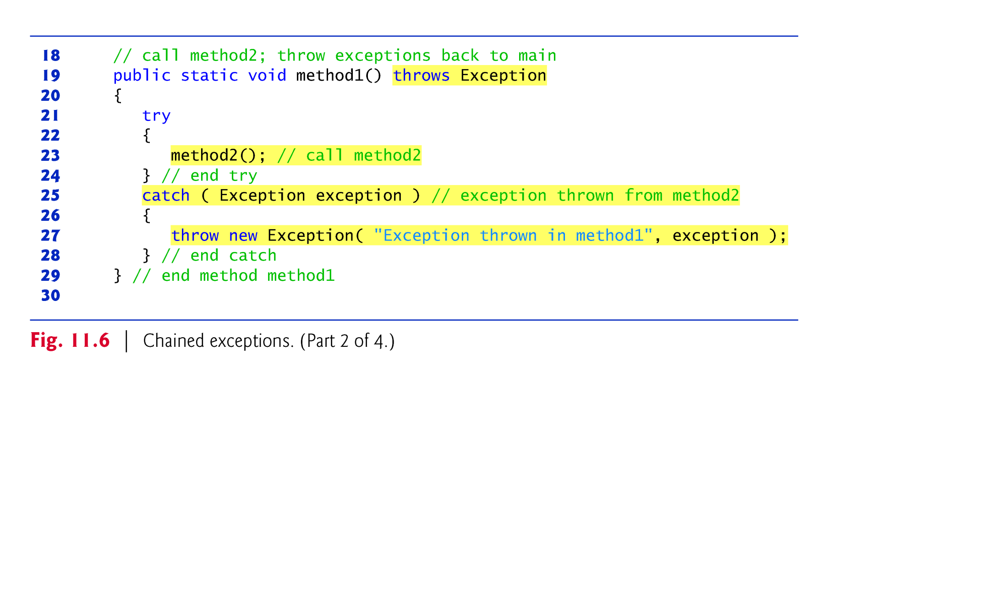

Slide 61
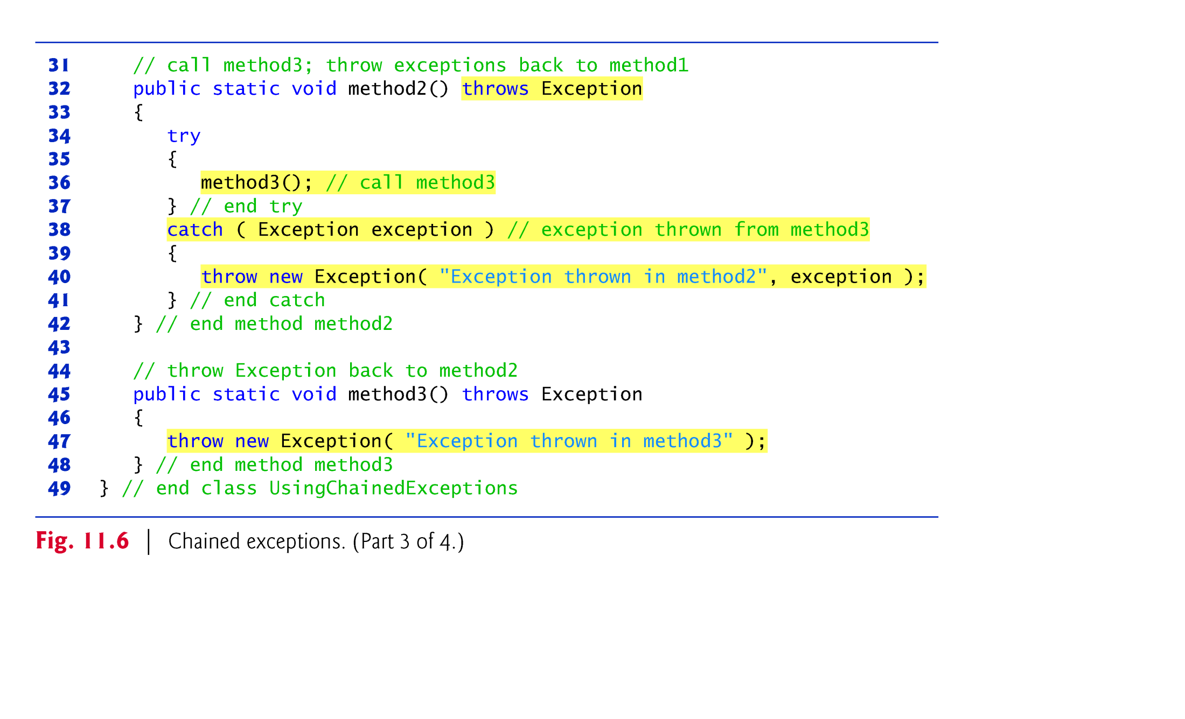

Slide 62
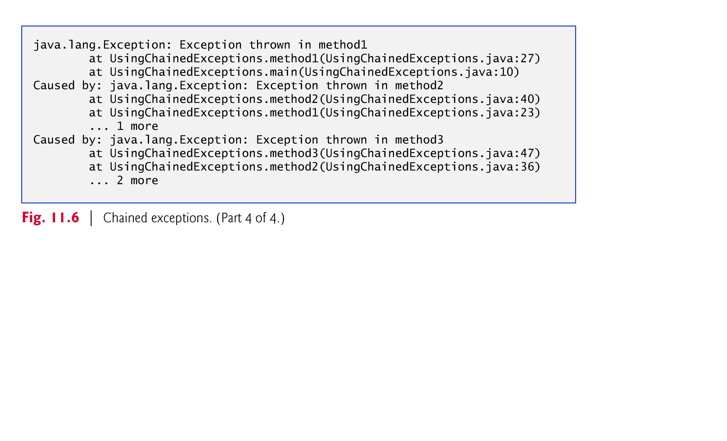

Slide 63
11.9 Declaring New Exception Types
Sometimes it’s useful to declare your own exception classes that are specific to the problems that can occur when another programmer uses your reusable classes.
A new exception class must extend an existing exception class to ensure that the class can be used with the exception-handling mechanism.

Slide 64
11.9 Declaring New Exception Types (cont.)
A typical new exception class contains only four constructors:
one that takes no arguments and passes a default error message String to the superclass constructor;
one that receives a customized error message as a String and passes it to the superclass constructor;
one that receives a customized error message as a String and a Throwable (for chaining exceptions) and passes both to the superclass constructor;
and one that receives a Throwable (for chaining exceptions) and passes it to the superclass constructor.

Slide 65


Slide 66


Slide 67
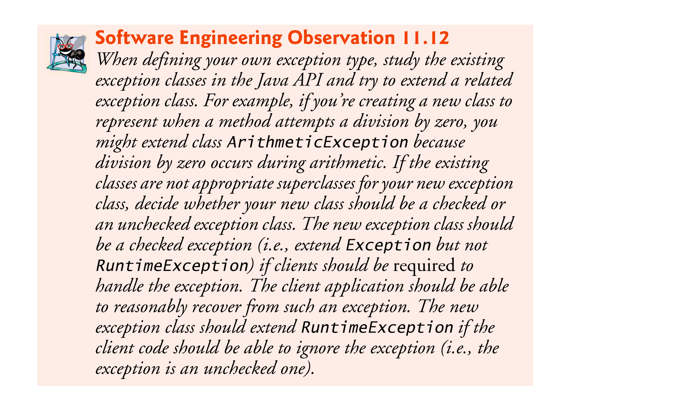

Slide 68


Slide 69
11.10 Assertions
Programmers spend significant amounts of time maintaining and debugging code.
To facilitate these tasks and to improve the overall design, they can specify the expected states before and after a method’s execution.
These states are called preconditions and postconditions, respectively.

Slide 70
11.10 Assertions (Cont.)
A precondition must be true when a method is invoked.
Describes constraints on method parameters and any other expectations the method has about the current state of a program just before it begins executing.
If the preconditions are not met, the method’s behavior is undefined.
You should never expect consistent behavior if the preconditions are not satisfied.

Slide 71
11.10 Assertions (Cont.)
As an example, examine String method charAt, which has one int parameter—an index in the String.
For a precondition, method charAt assumes that index is greater than or equal to zero and less than the length of the String.
If the precondition is met, the postcondition states that the method will return the character at the position in the String specified by the parameter index.
Otherwise, the method throws an IndexOutOfBoundsException.
We trust that method charAt satisfies its postcondition, provided that we meet the precondition.
We need not be concerned with the details of how the method actually retrieves the character at the index.

Slide 72
11.11 Assertions (Cont. )
When implementing and debugging a class, it’s sometimes useful to state conditions that should be true at a particular point in a method.
Assertions help ensure a program’s validity by catching potential bugs and identifying possible logic errors during development.
Preconditions and postconditions are two types of assertions.

Slide 73
11.11 Assertions (Cont.)
Java includes two versions of the assert statement for validating assertions programatically.
assert evaluates a boolean expression and, if false, throws an AssertionError (a subclass of Error).
assert expression;
throws an AssertionError if expression is false.
assert expression1 : expression2;
evaluates expression1 and throws an AssertionError with expression2 as the error message if expression1 is false.
Can be used to programmatically implement preconditions and postconditions or to verify any other intermediate states that help you ensure your code is working correctly.

Slide 74
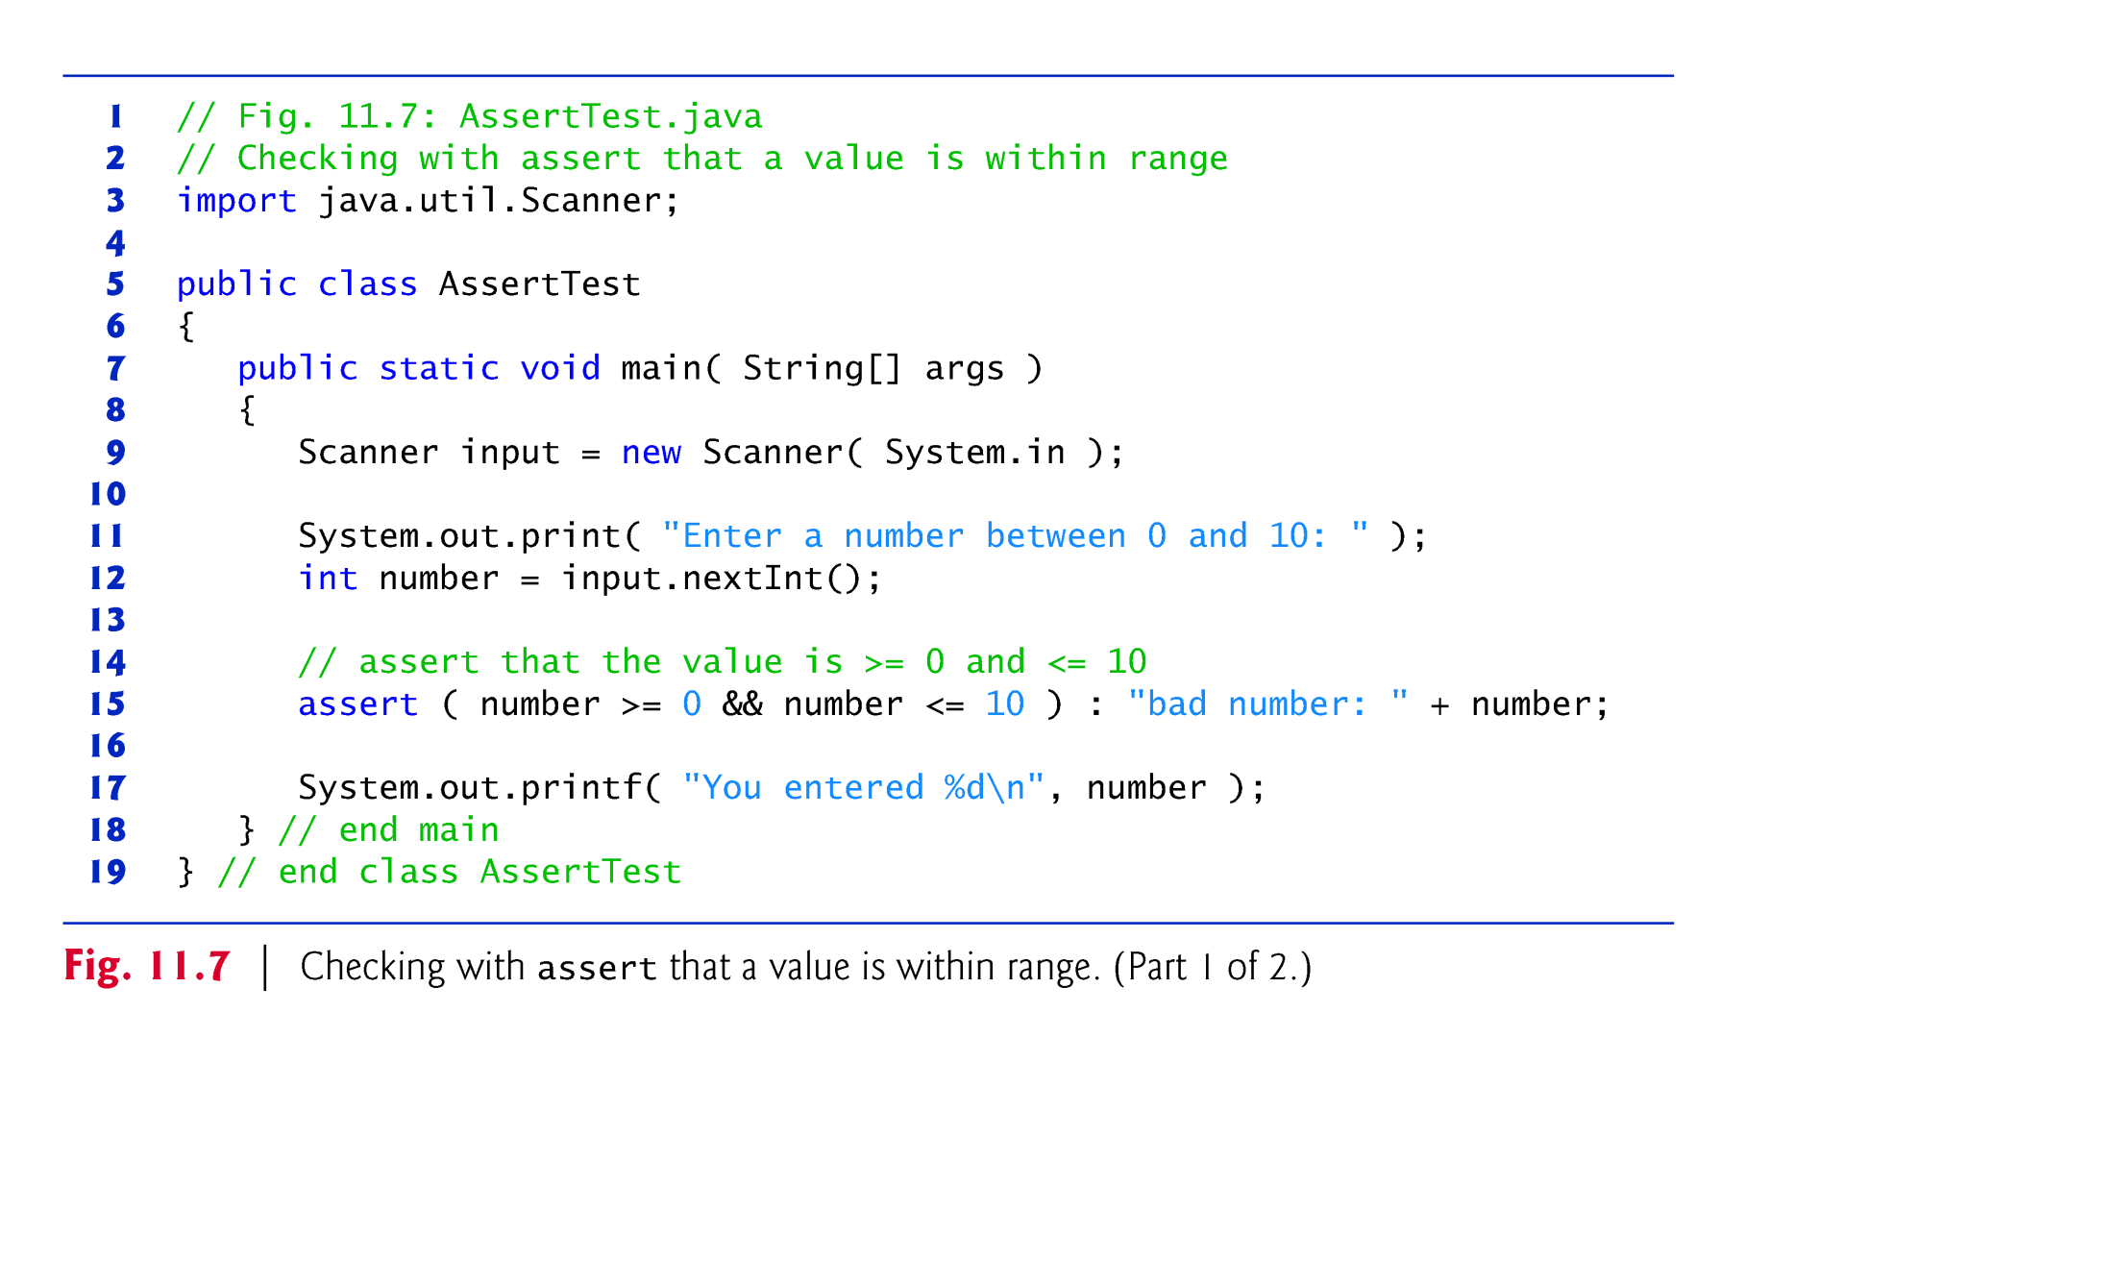

Slide 75
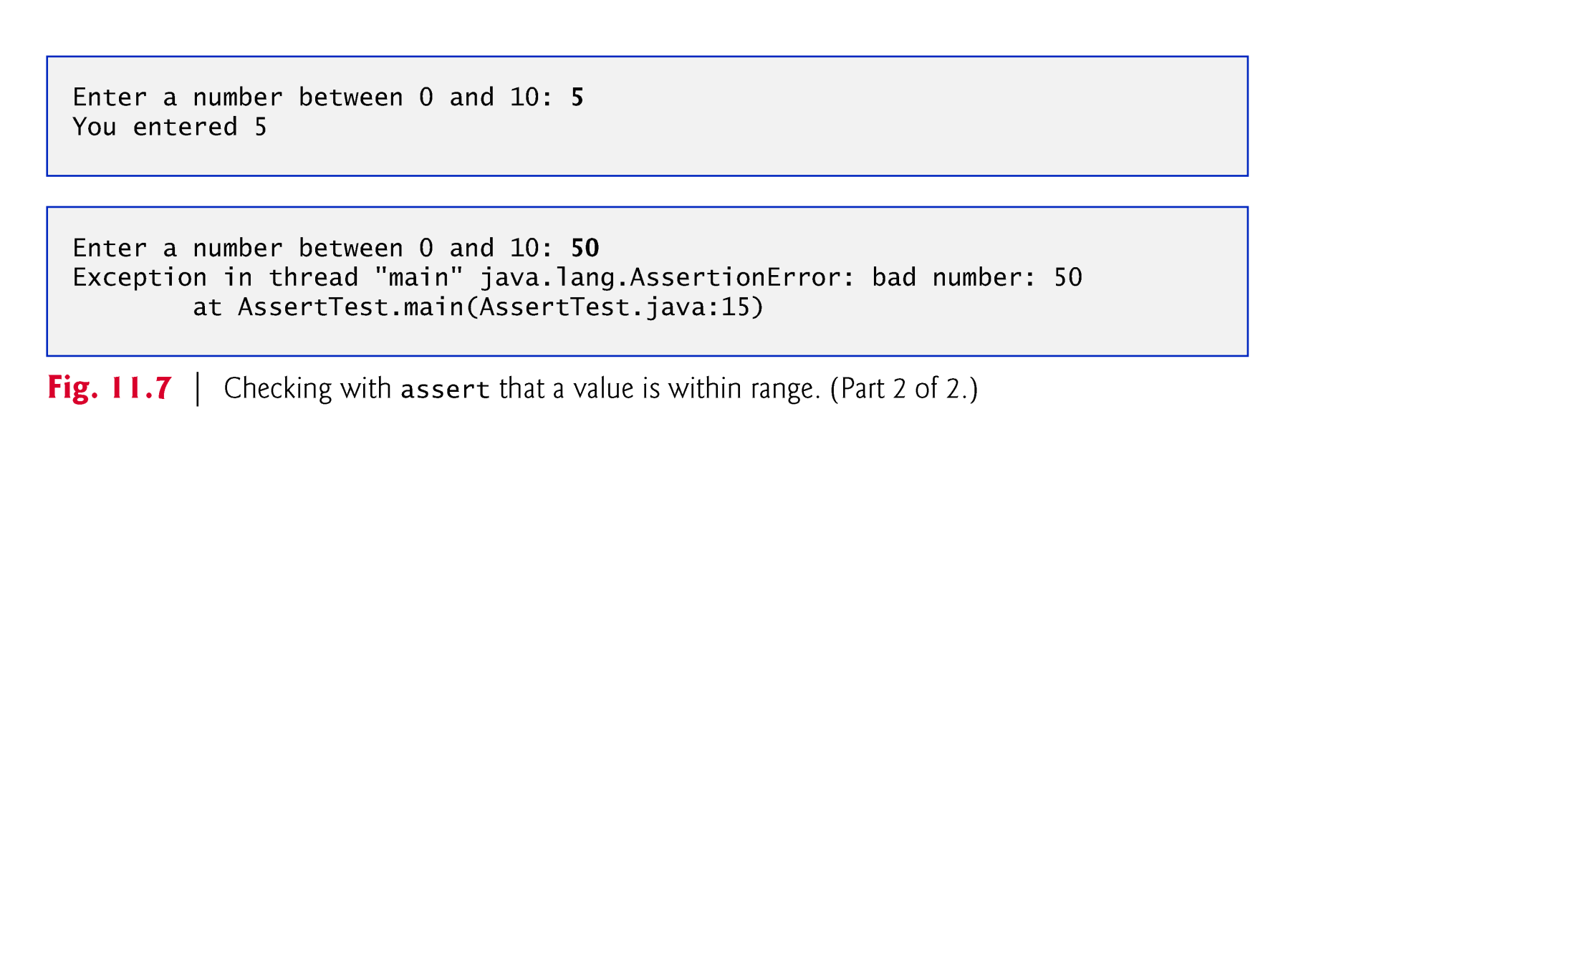

Slide 76
11.11 Assertions (Cont.)
You use assertions primarily for debugging and identifying logic errors in an application.
You must explicitly enable assertions when executing a program
They reduce performance.
They are unnecessary for the program’s user.
To enable assertions, use the java command’s -ea command-line option, as in
java -ea AssertTest

Slide 77
11.11 Assertions (Cont.)
Users should not encounter any AssertionErrors through normal execution of a properly written program.
Such errors should only indicate bugs in the implementation.
As a result, you should never catch an AssertionError.
Allow the program to terminate when the error occurs, so you can see the error message, then locate and fix the source of the problem.
Since application users can choose not to enable assertions at runtime
You should not use assert to indicate runtime problems in production code.
You should use the exception mechanism for this purpose.

Slide 78
11.12 try-with-Resources: Automatic Resource Deallocation
Typically resource-release code should be placed in a finally block to ensure that a resource is released, regardless of whether there were exceptions when the resource was used in the corresponding try block.

Slide 79
try (ClassName theObject = new ClassName()) {
// use theObject here, then release its resources at
// the end of the try block
}
catch (Exception e) {
// catch exceptions that occur while using the resource
}
where ClassName is a class that implements AutoCloseable.
This code creates a ClassName object, uses it in the try block, then calls its close method at the end of the try block—or, if an exception occurs, at the end of a catch block—to release the object’s resources.

